Slide 1
A Comparative Evaluation of Three Skin Color Detection Approaches
Dennis Jensch, Daniel Mohr, Clausthal University
Gabriel Zachmann, University of Bremen
VRAR 2012, Sep 2012, Düsseldorf

Slide 2
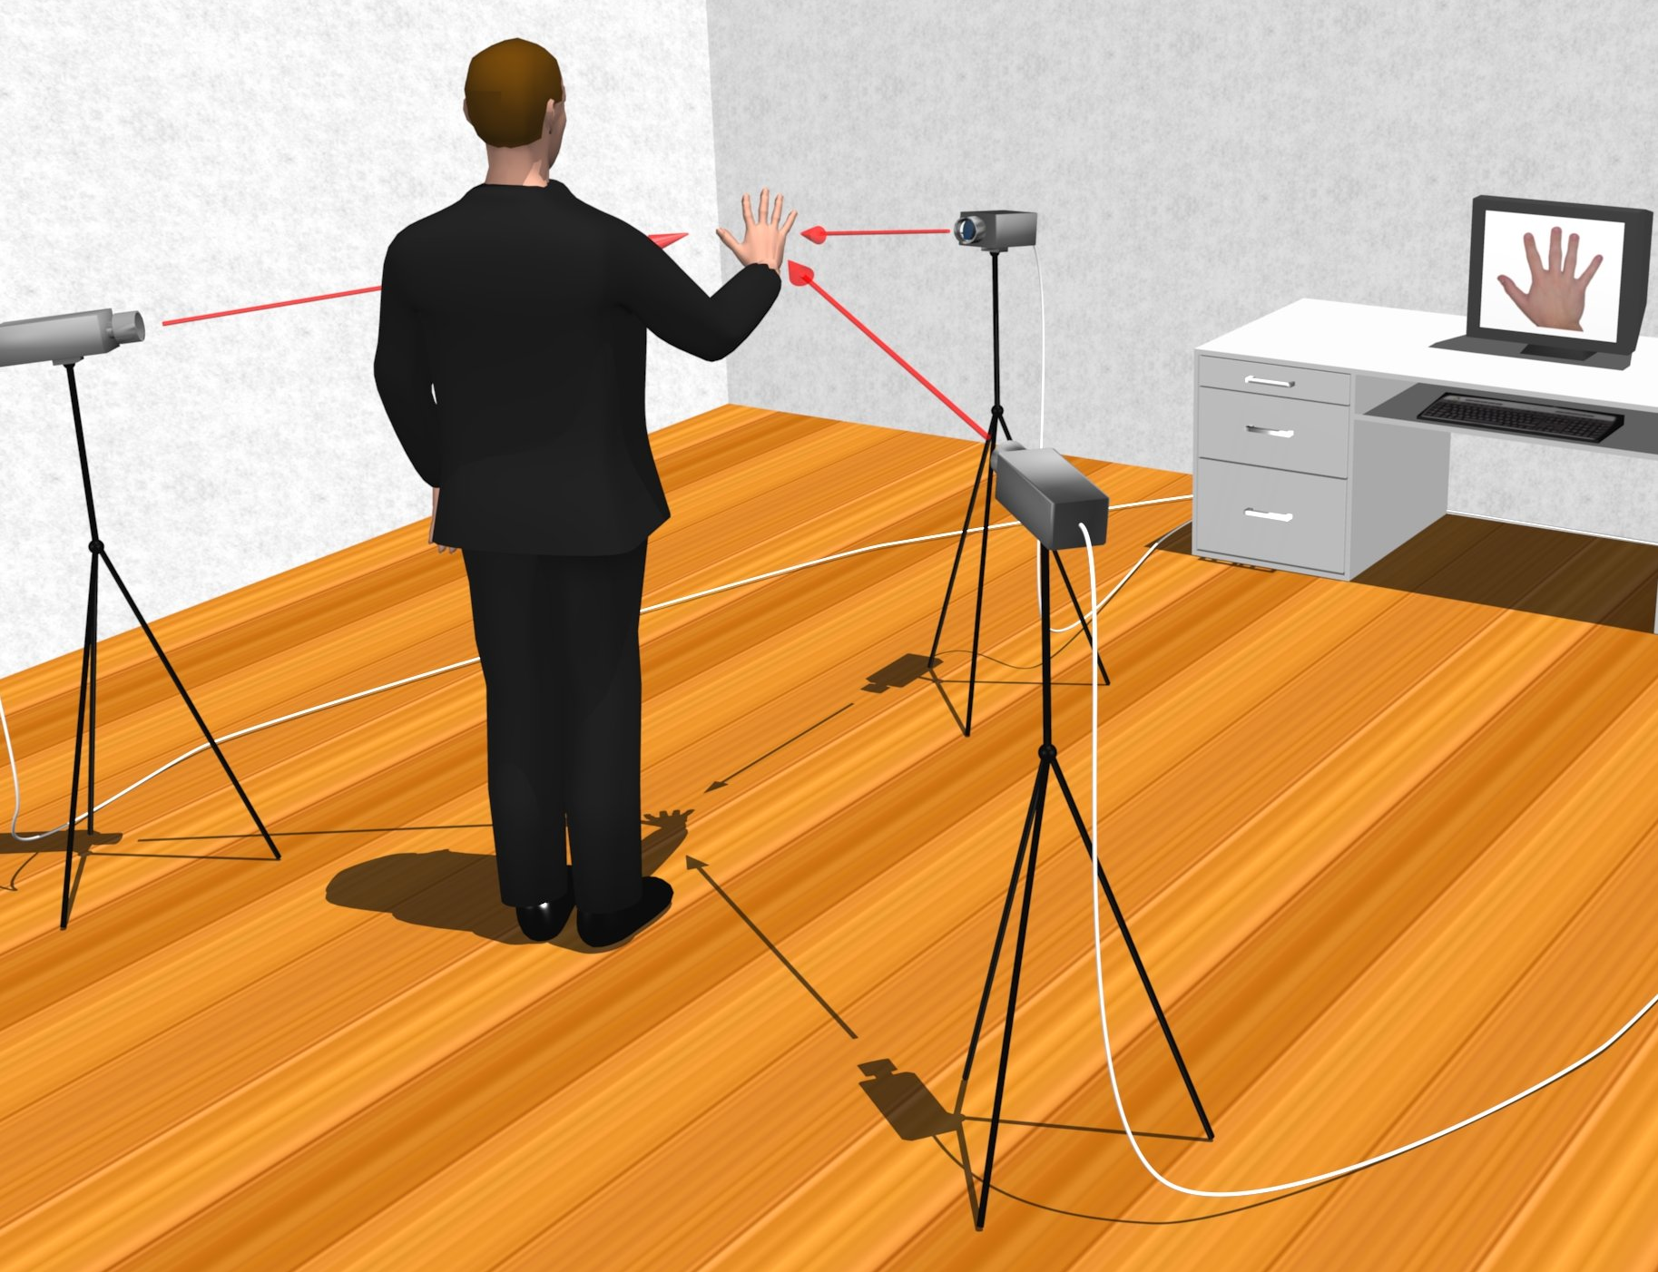
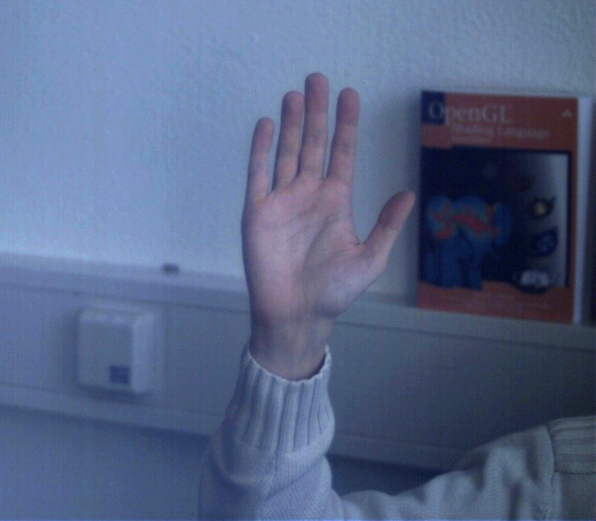
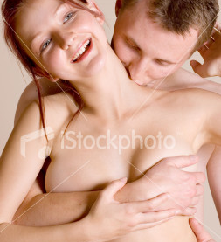
Motivation
Long-term goal: marker-less hand tracking
Real-time estimation of pose and human hand
Skin segmentation helps to
localize hand very fast (if robust)
match hand temlates very fast
Further applications
Detect person/adult images (e.g. filtering in search engines)
Face detection
Many more...
ZENSORED
ZENSORED
ZENSORED
Motivation Approaches Evaluation Method Results Conclusions

Slide 3
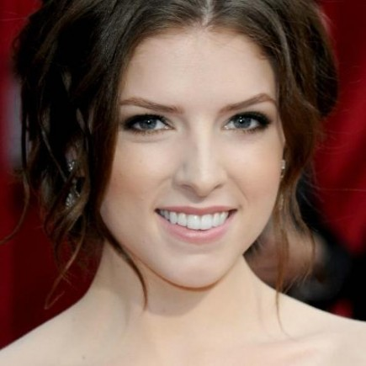
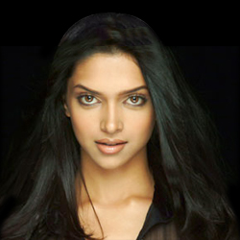
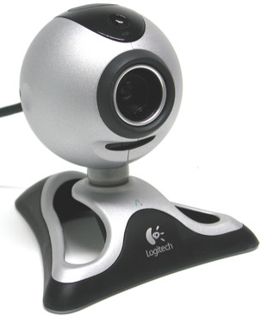
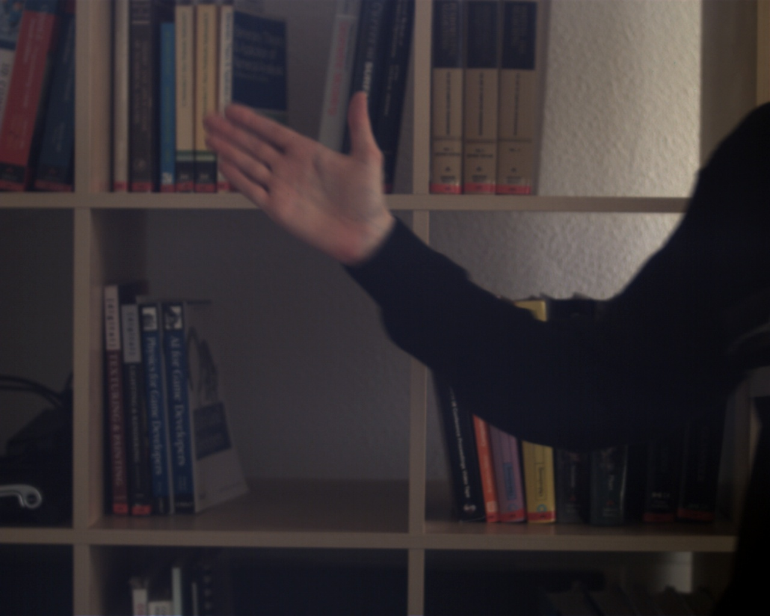
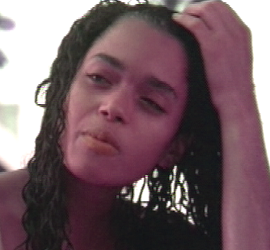
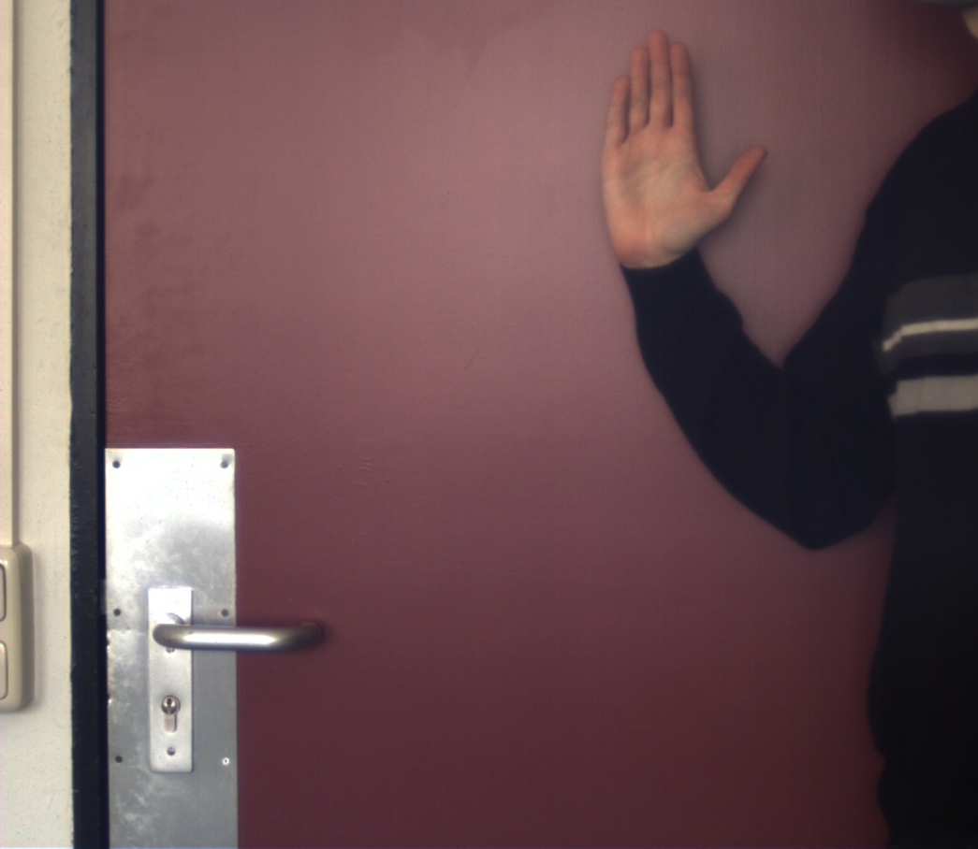
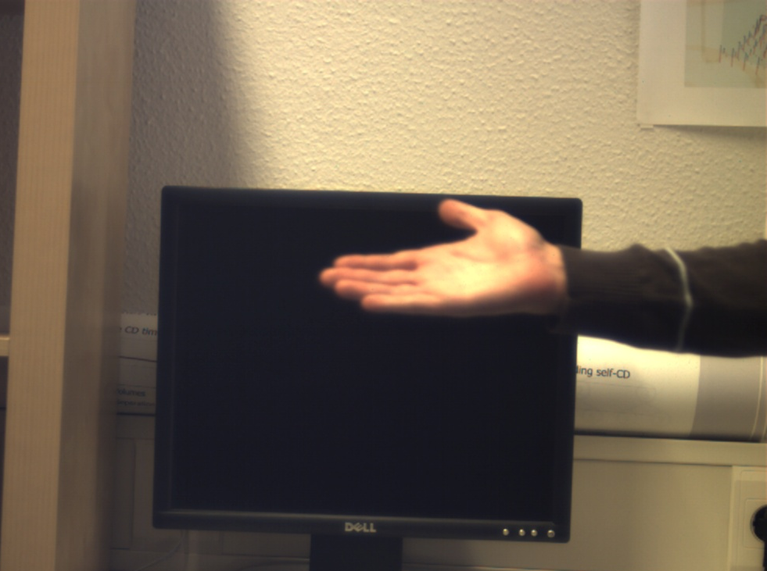
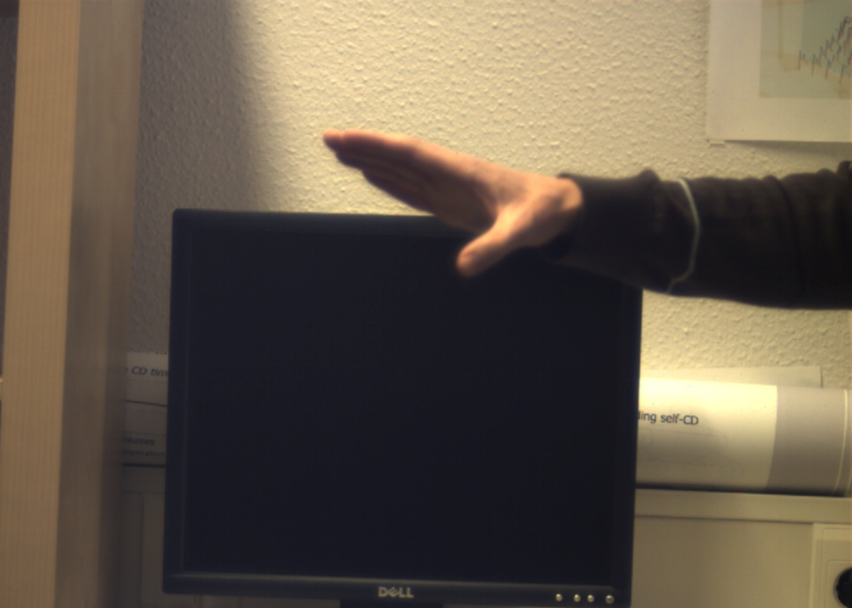
Challenges of Skin Segmentation
Different ethnic groups
Skin color in the background
Camera limitations
Illumination conditions
Motivation Approaches Evaluation Method Results Conclusions

Slide 4
Approaches Considered in the Following
RehgJones [M. J. Jones and J. M. Rehg, IJCV 1999]
Learn skin color distribution from a manually labeled dataset
HybridClustering [D. Mohr and G. Zachmann, CAIP 2007]
Combined color and image space clustering
Classification is done region-wise (opposed to pixel-wise)
NeuralGasColorClustering
Inspired by HybridClustering with two modifications
Replace EM by Matrix Neural Gas
Replace the way the number of clusters is determined
Motivation Approaches Evaluation Method Results Conclusions

Slide 5
RehgJones
Learn skin color distribution offline
Dataset randomly chosen from World Wide Web
~ 1 billion pixels
Manually labeled as skin / non-skin
Color distributions for skin and non-skin
Image classification:
Per pixel
controls offset between false positive and false negatives
Motivation Approaches Evaluation Method Results Conclusions
Notes:
Theta ~ 0: viele false positives
Theta ~ 1: viele false negatives
State of the art, deshalb
$P(rgb|skin) = \frac{s[rgb])}{T_S}$
---
$P(rgb|\neg skin) = \frac{s[\neg rgb])}{T_N}$
---
$\frac{P(rgb|skin)}{P(rgb|\neg skin)} \ge \Theta$

Slide 6
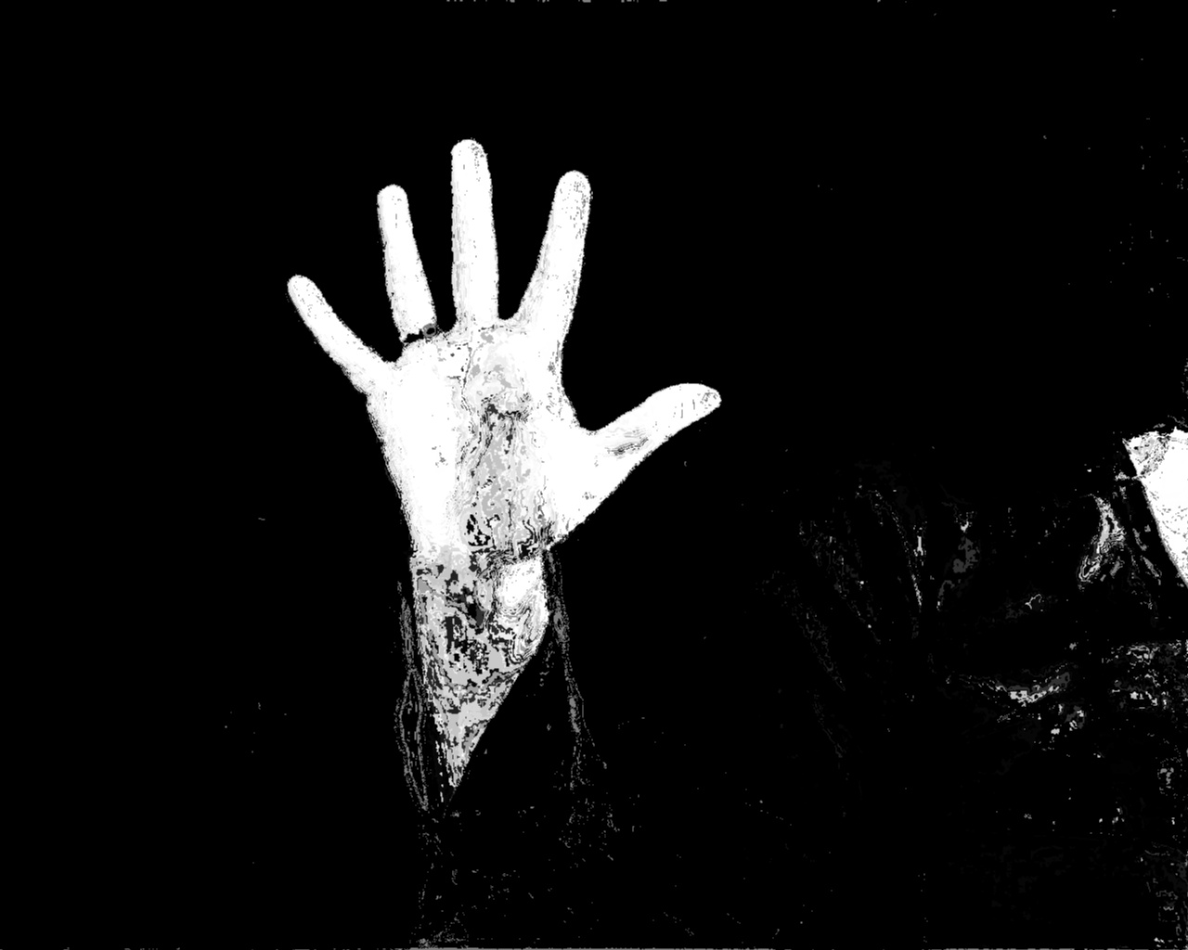
HybridClustering
Learn a rough skin direction vector offline
Online classification:
Cluster the image in color space
Hierarchical EM
Smoothing of clusters in image space
Classify image clusters as skin / non-skin
Reproject to image space
Keep image regions together
Depends on convergence behavior of EM
Non-skin
skin
Motivation Approaches Evaluation Method Results Conclusions
Notes:
TODO: algo auf dem bild laufen lassen, skinseg bild reinpasten
Von uns entwickeltes Verfahren....

Slide 7
NeuralGasColorClustering
Tries to improve upon HybridClustering
EM algorithm
sensitive to initialization
Hierarchical clustering to determine number of clusters
Could choose wrong number of clusters
Image edges as cluster quality measure
Is this really the best option?
NeuralGasColorClustering
Matrix Neural Gas
Less sensitive to initialization
Succesively test different number of clusters
Slower but expected to perform better
Test 3 different measures
Border Length
Border Edges
Color Space Compactness
Motivation Approaches Evaluation Method Results Conclusions

Slide 8
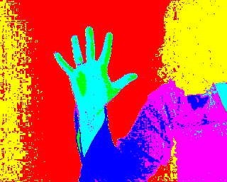
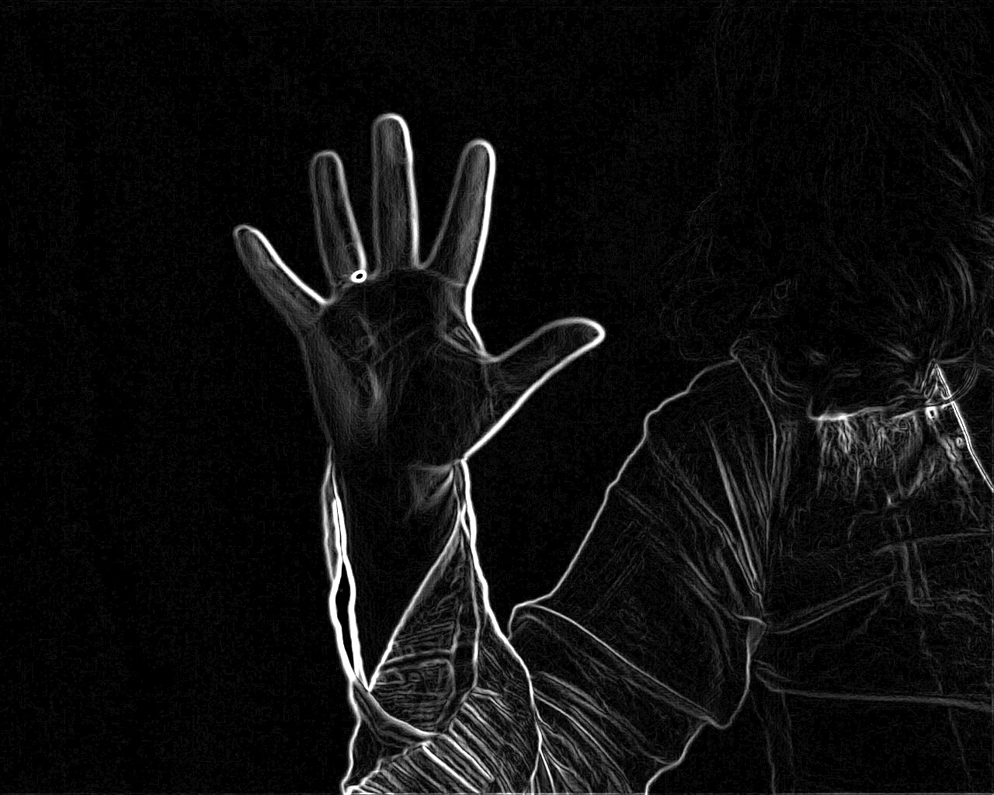
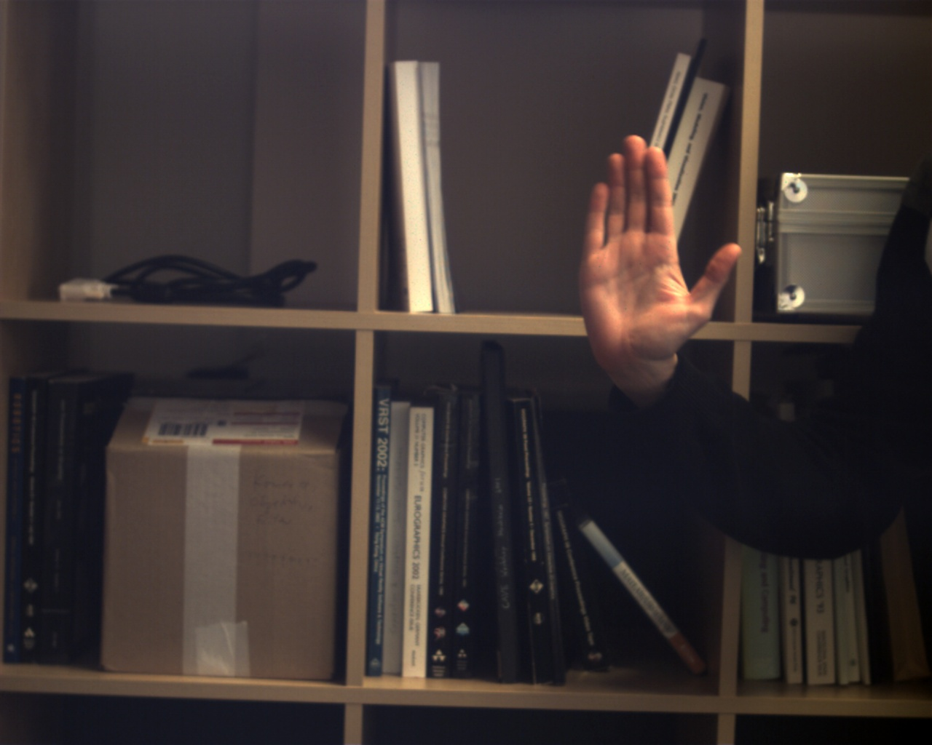
Quality Measures for Cluster in NeuralGasColorClusters
Border Length
Penalize unsharp borders
Penalizes long contours
Border Edges
Penalized edges across objects
Sensitive to edge noise and missing edges
Color Space Compactness
Penalized bad color distribution
Clusters can be distorted
Motivation Approaches Evaluation Method Results Conclusions
Notes:
Damit bin ich noch nicht wirklich zufrieden....

Slide 9
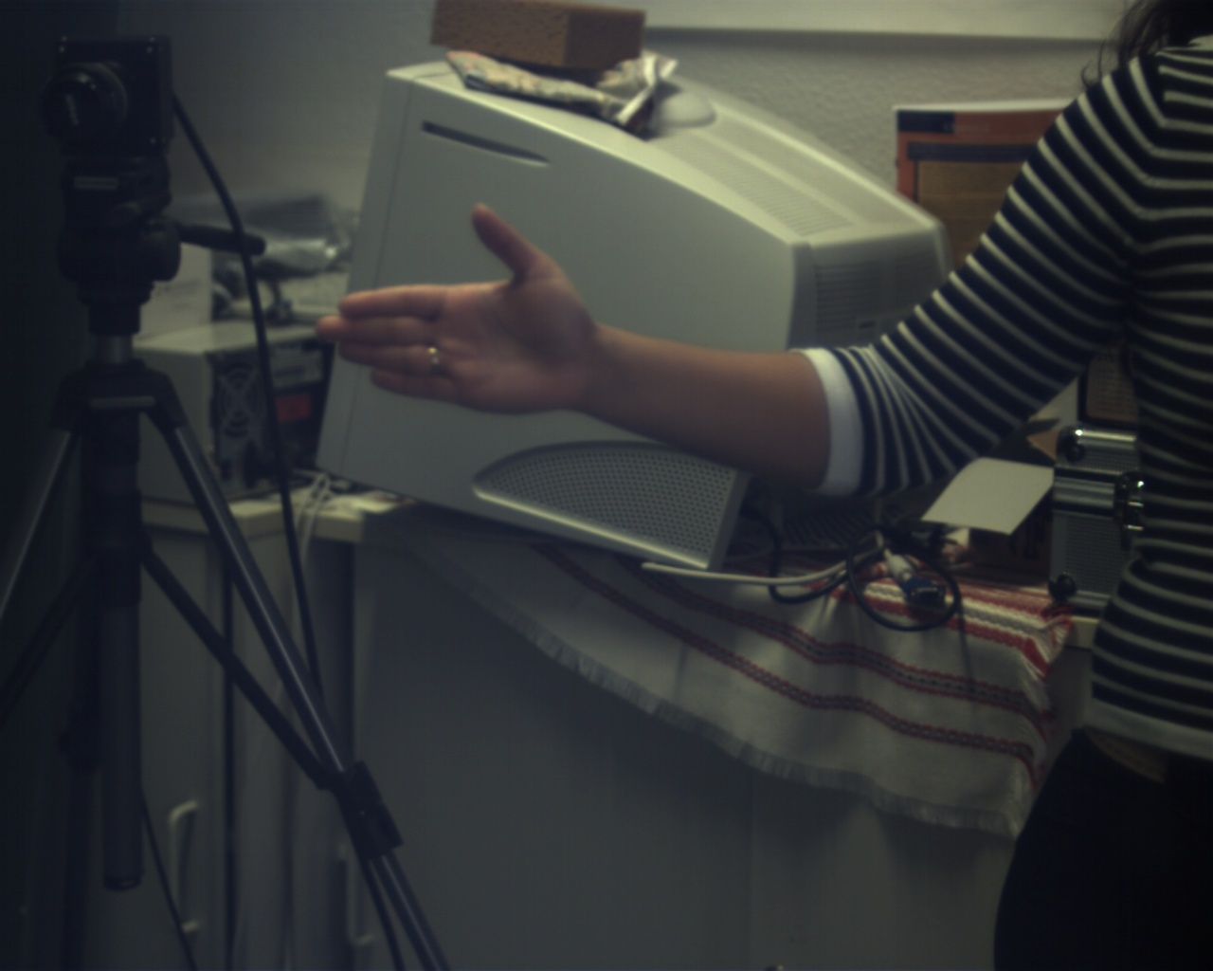
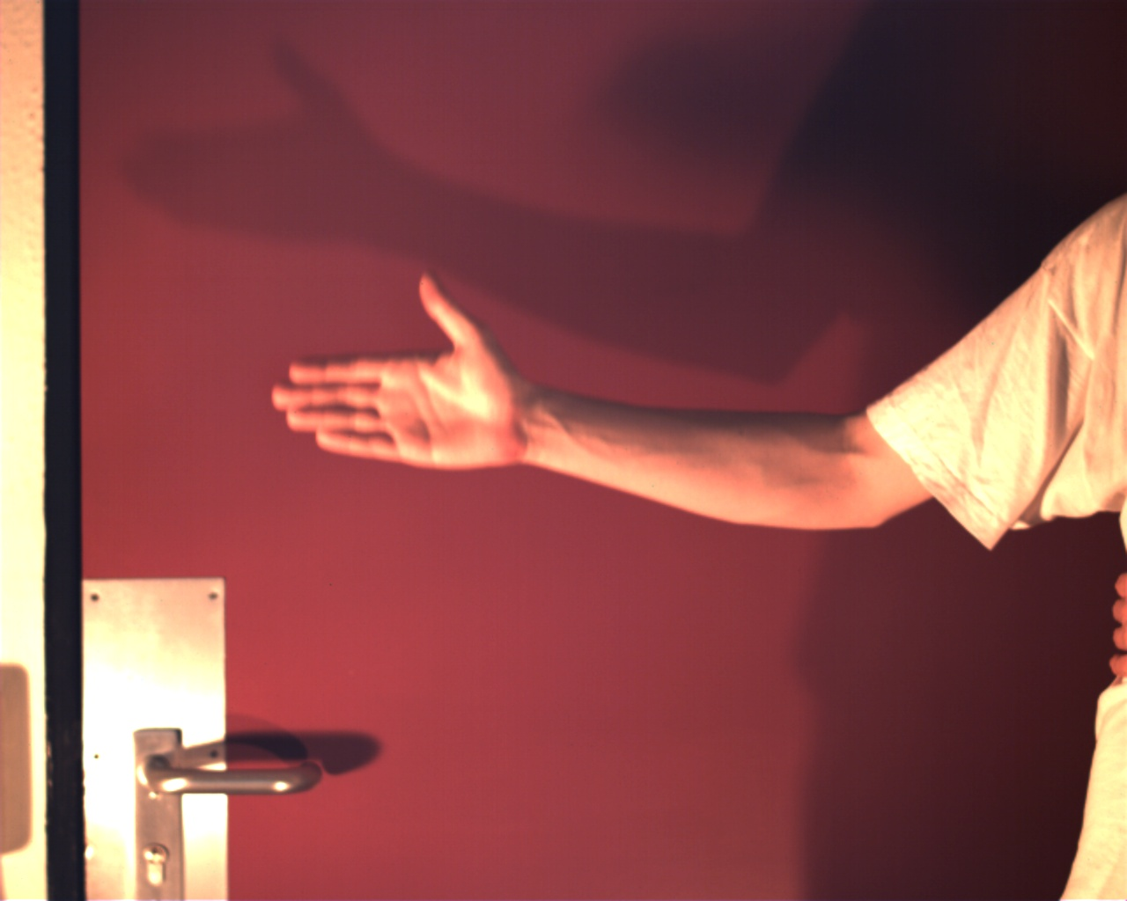
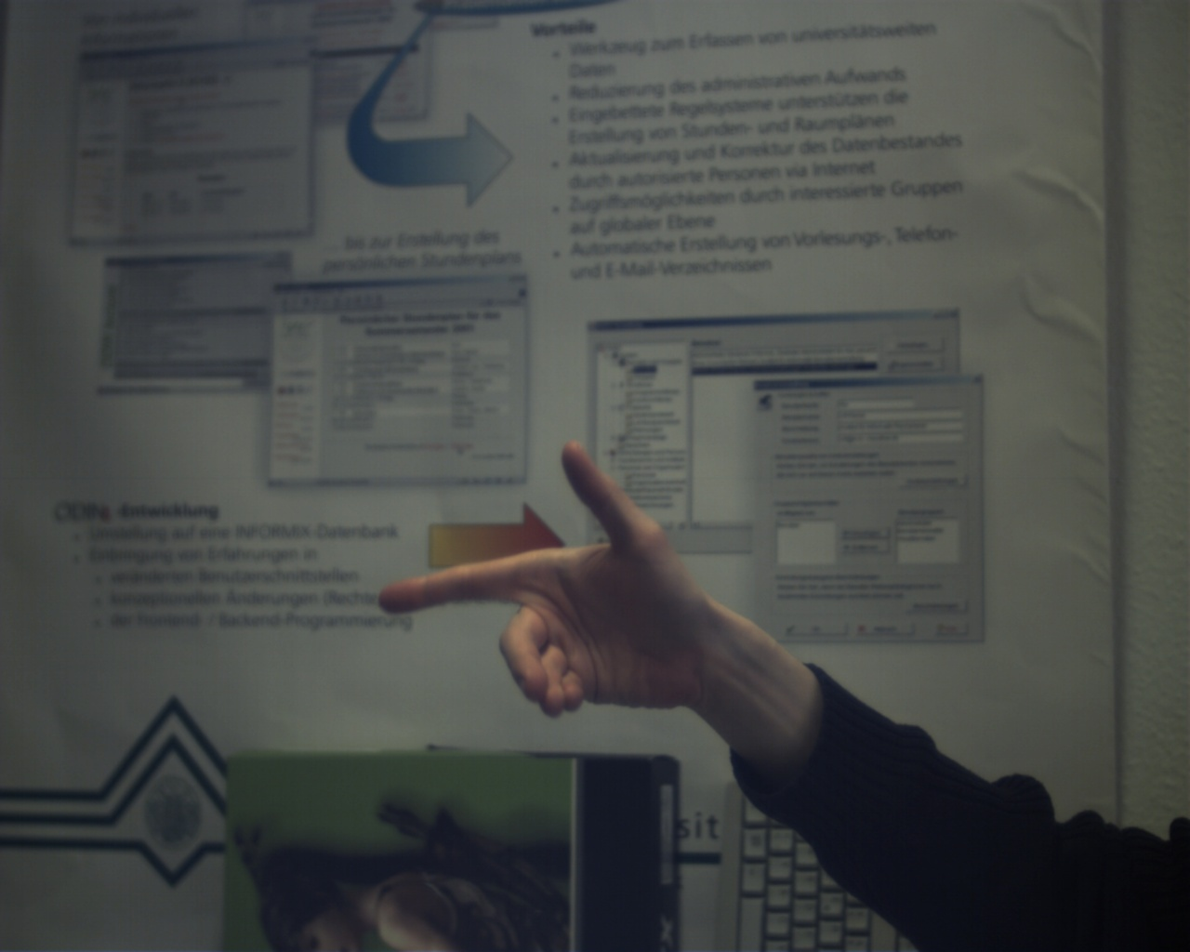
Ground Truth Data
15 data sets
Background
Simple
Complex
Skin colored
Illumination: most images contain underexposed, normal exposed and overexposed regions
Motivation Approaches Evaluation Method Results Conclusions
Notes:
Zur evaluation der 3 Verfahren haben wir einen gt datensatz erstellt....

Slide 10
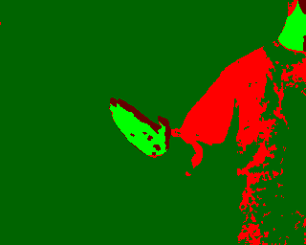
Cases Possible after Segmentation
Correctly classified pixels
True Negatives (TN)
non-skin
True Positives (TP)
skin
Wrongly classified pixels
False Negatives (FN)
skin classified as non-skin
False Positives (FP)
non-skin classified as skin
Motivation Approaches Evaluation Method Results Conclusions
Notes:
Wendet man nun ein segmentierungsverfahren an, gegeben die ground truth daten, erhält man 4 fälle, die in 2 kategorien zu unterteilen sind...

Slide 11
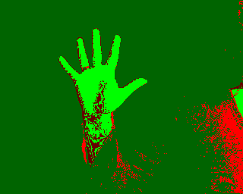
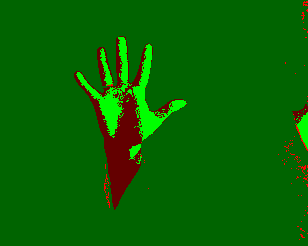
The Receiver Operating Characteristic Curve
ROC curve captures relation between
True Positive Rate = $\frac{TP}{TP+FN}$
False Positive Rate = $\frac{FP}{FP+TN}$
True positive rate
False positive rate
Motivation Approaches Evaluation Method Results Conclusions
Notes:
Ermöglicht visuelle Auswertung der Ergebnisse
(Entscheidung gegen Precision-Recall, da nach eigenem Empfinden keine Vorteile bzw ROC als angenehmer empfunden)

Slide 12
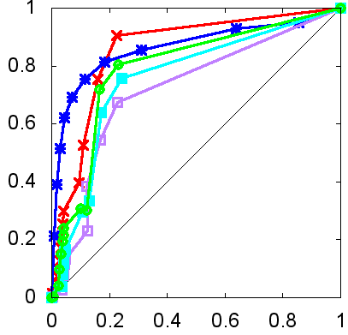
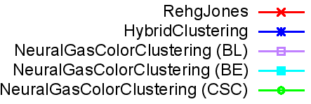
Main Result: Overall Segmentation Quality
HybridClustering performs best on average
NeuralGasColorSpaceClustering surprisingly has worst quality
Color Space Compactness yields better result compared to the other cluster quality measures
True positive rate
False positive rate
Motivation Approaches Evaluation Method Results Conclusions
Notes:
Einfacher Hintergrund: Segmentierungsquali relativ gut
Komplexer Hintergrund: RehgJones&HybridClustering schlechtere Ergebnisse; NeuralGasColorClustering schlechteste Ergebnisse (Varianz)
HybridClustering am besten, NeuralGasColorClustering am schlechtesten
HybridClustering stellenweise unterhalb von RehgJones (RJ-Wert=0.01). Wert in realer Anwendung aber nicht vorkommend.

Slide 13
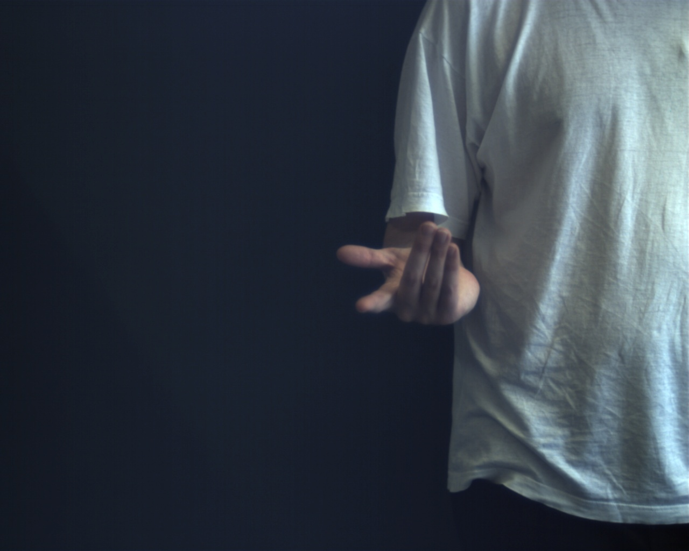
The 3 most different data sets for detailed analysis
Simple background
Complex background
Skin colored background
Motivation Approaches Evaluation Method Results Conclusions
Notes:
Betrachtung einzelner prägnanter Datensätze
Manche Datensätze ähneln sich stark & bringen keine Vorteile
Reduktion auf die verschiedenen Aufnahmebedingungen (wie vorher erklärt)

Slide 14
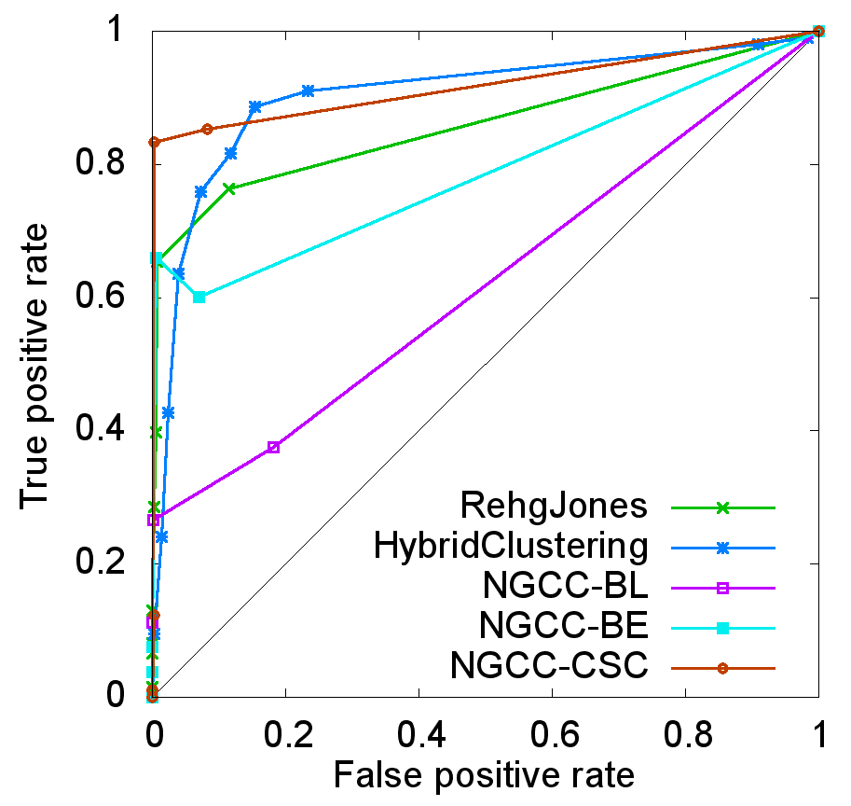
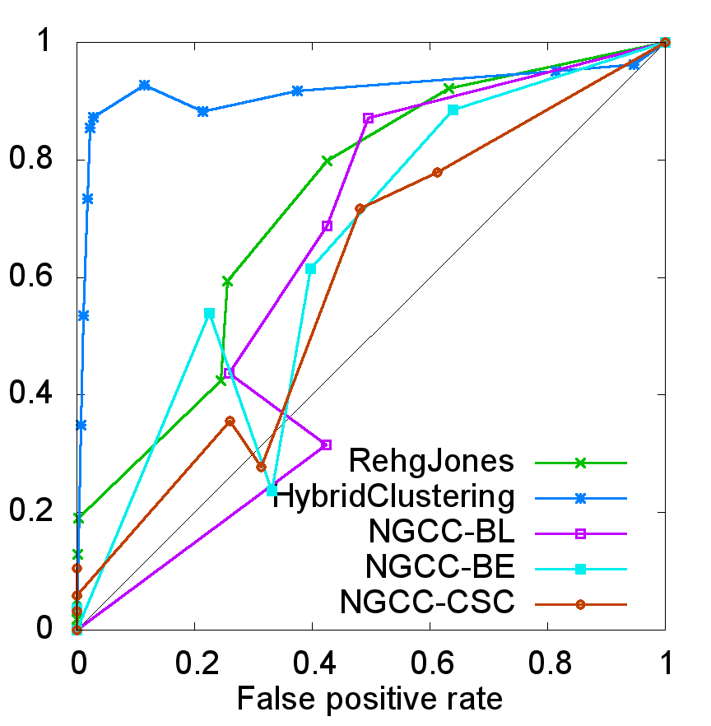
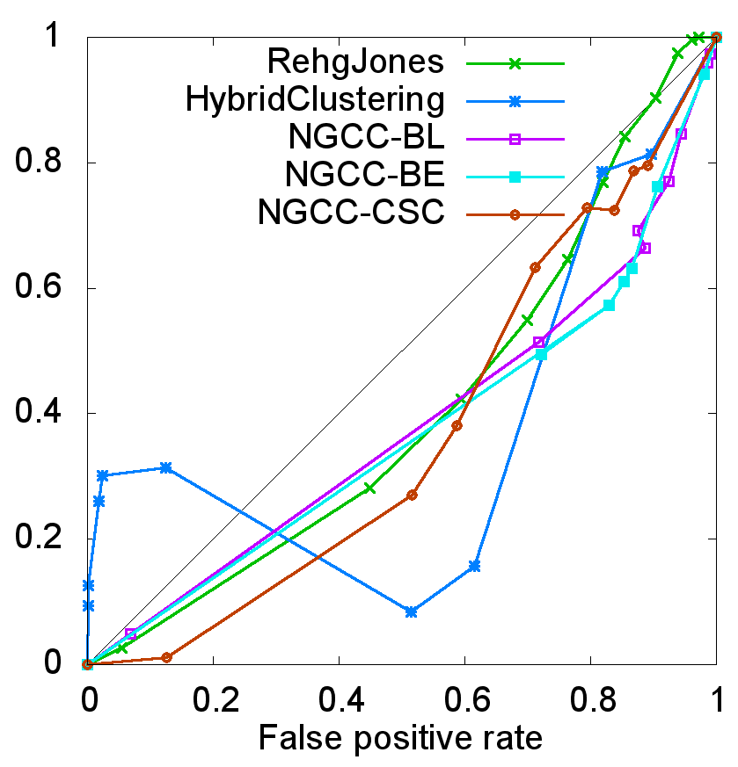
Individual Segmentation Quality: Data Sets
HybridClustering yields best results with high acceptance threshold even for red-door dataset
Motivation Approaches Evaluation Method Results Conclusions

Slide 15
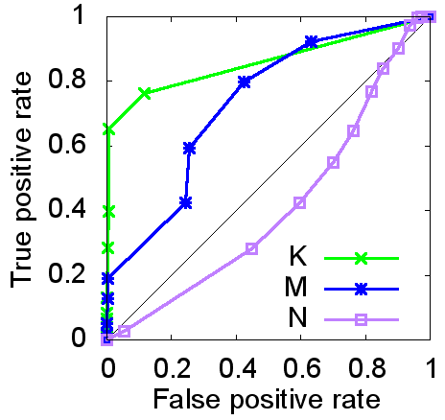
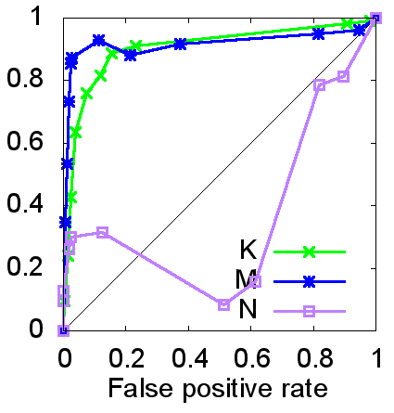
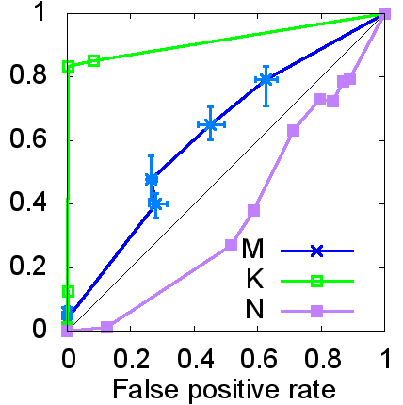
Individual Segmentation Quality: Approaches
RehgJones
Moderate variation between different data sets
Except red-door dataset
HybridClustering
Moderate variation between different data sets
NeuralGasColorClustering
High variation between different data sets
Motivation Approaches Evaluation Method Results Conclusions
Notes:
Für jeden Algo: Variation zw. Datensätzen untersucht

Slide 16
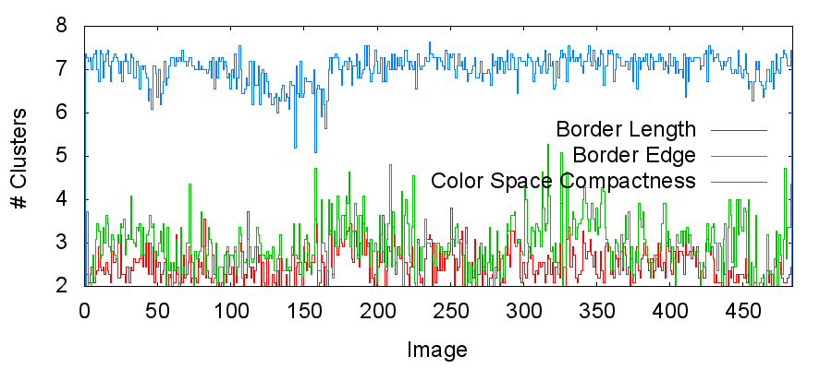
Cluster Quality Measures
Color Space Compactness yields by fast highest number of clusters
High number of clusters yields better segmentation results
Better use too many than not enough clusters
Motivation Approaches Evaluation Method Results Conclusions
Notes:
Plausibel: unterteilung zu gering: haut+nicht-haut falsch klassifiziert
unterteilung von haut, können trotzdem die meisten skin-cluster als haut classifiziert

Slide 17
Computation Time
Approach | Time (ms) | Std. Dev (ms)
RehgJones | 1.23 | 0.06
HybridClustering | 508 | 442
NeuralGasColorClustering - BL | 45 013 | 2 458
NeuralGasColorClustering - BE | 45 886 | 2 635
NeuralGasColorClustering - CSC | 45 460 | 2 961

Slide 18
Conclusion
Compared the three skin segmentation approaches (RehgJones, HybridClustering, NeuralGasColorClustering
Method of evaluation:
Ground truth dataset of about 500 images
ROC curve analysis
Main result: HybridClustering performs best on average
Detailed analysis reveals high variance between individual datasets
Apparently, cluster-based segmentation algorithms better use too many cluster than too few
Motivation Approaches Evaluation Method Results Conclusions
Notes:
Zusammenfassend haben wir...

Slide 19
Future Work
Further investigate hypothesis about relation between number of clusters and overall segmentation quality
Evaluate further skin segmentation approaches e.g. [Sigal et al., CVPR 2000]
Extend ground truth dataset
Integrate image space smoothing in NeuralGasColorClustering
Motivation Approaches Evaluation Method Results Conclusions
Notes:
Sigal nimmt RehgJOnes als init, passt distribution an basierend auf letztem Frame
L. Sigal, S.Sclaroff and V.Athitsos: Estimation and Prediction of Evolving Color Distributions
for Skin Segmentation Under Varying Illumination. IEEE Conf. on Computer
Vision and Pattern Recognition (2000)

Slide 20
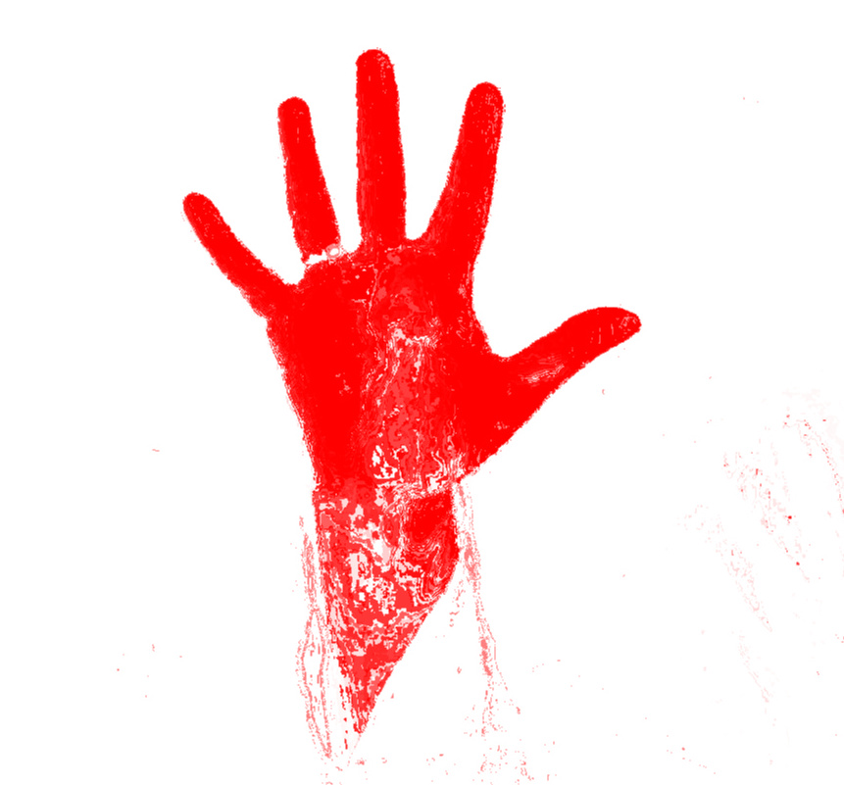
Thanks for your attention!
Questions?
Motivation Edge-based similarity Area-based similarity Fast Template Search Strategies Conclusion

