Slide 1
Overview for annotating grasps
Julie, Nadia, Saleem and Syawish

Slide 2
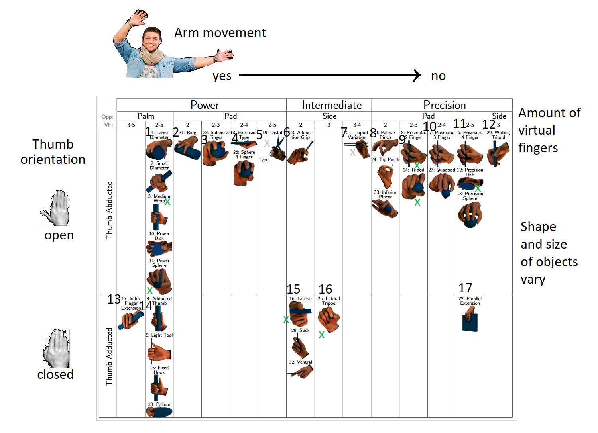
Overview
Notes:
The Paper “Grasp Taxonomy” already offered different visualisations of data bases with all of the 33 chosen grasps.
We chose one that we thought was easy to understand and added a few comments and images in order to find certain types of grasps faster. The rows categorize the different thumb positions: Open and closed. And the collumns show the so called “opposition type”, whether or not arm movement is required for the grasp. Within a cell the same type of grasp is depicted, only the shapes and sizes of the objects vary: Therefor the 33 grasps can be grouped into 17 grasps when abstracting the object. We also added those group numbers.

Slide 3
Example usage
Hand mixer
Cup
Cutting board
Notes:
To showcase the usage of the overview graphic we inserted some kitchen-related examples!

Slide 4
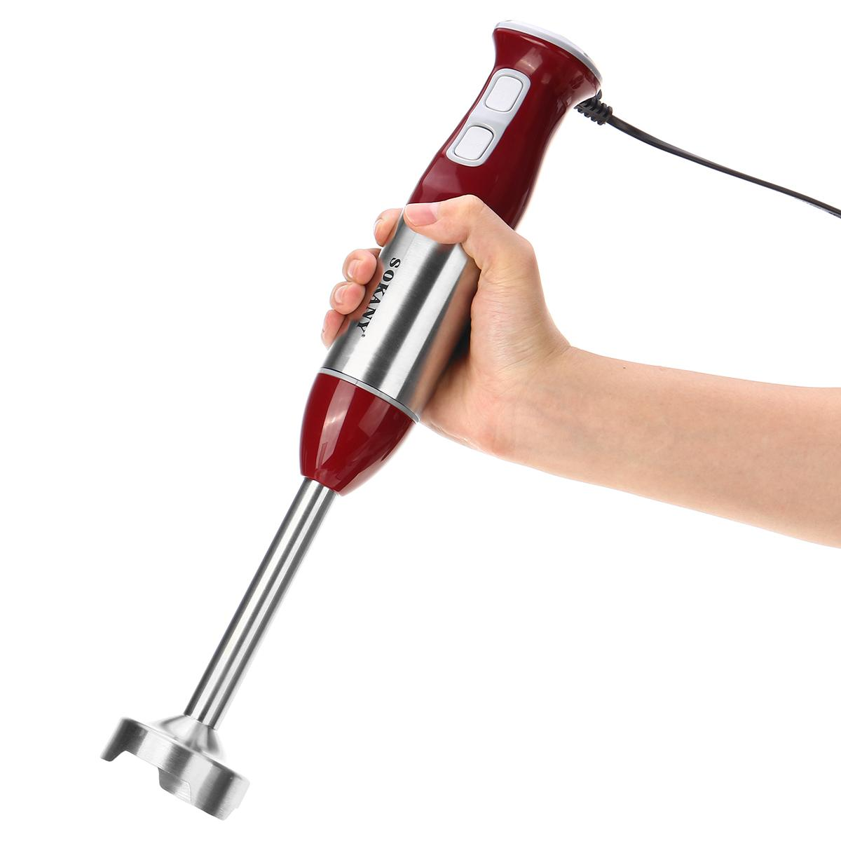
Holding a hand mixer
Notes:
The first example is holding a hand mixer. So let’s take a look at the overview to find out the typ of grasp!

Slide 5
Notes:
When holding a hand mixer the thumb points away from the other fingers, therefor we only look at the open orientation: The abducted thumb. Also in order to hold it arm movement is required, therefor it is a “power” grasp. As the sizes of hand mixers can vary, three of the grasp types can be taken into consideration.

Slide 6
Holding a hand mixer
Grasp types:
1.
2.
3.
overview
Depending on
the size of
the mixer
Notes:
In the case of holding a hand mixer the following grasp types might be annotated: 1, 2 and 3

Slide 7
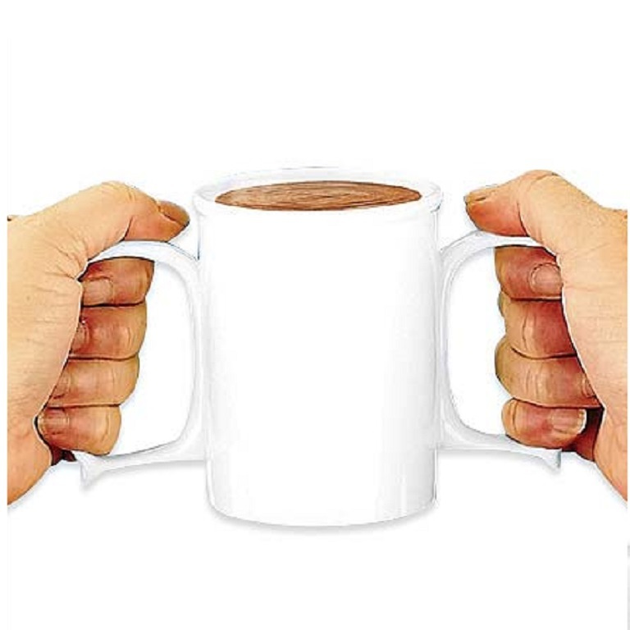
Holding A Cup
Notes:
Now we will move forward towards this example : “ Holding a Cup”

Slide 8
Notes:
As you can see in this table that we need a closed orientation because thumbs are Adducted while holding a cup.And in order to hold a cup there is not much arm movement involved so we can put it in the category of “ Intermediate Grasp”. As the size of cup varies but the size of handle does not vary too much so we can consider grasp type 15 and 16 for annotation.

Slide 9
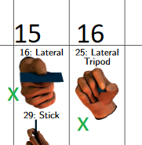
Holding a Cup
Grasp types:
16
25
overview

Slide 10
Holding A Cutting Board

Slide 11
Notes:
As you can see in this table that for holding a cutting board we need a closed orientation and we don’t need arm power so this fits into the category of precision grasp.And can be annotated into category 17.

Slide 12
Holding A Cutting Board
Grasp types:
17
overview

