Slide 1
OverView on Interaction Metaphore
Murtaza Hussain

Slide 2
Purposed Interactions
Control radio/CD (Start/stop, skip track, volume, mute, pause, search for track)
Phone calls (select number, hang up, hold, emergency call, answer, search for contact, reject, redial)
Navigation system (Destination, graphics, on/off, traffic conditions, specify route among several options, common destinations)
Air conditioning (on/off, warmer/cooler, vents, inside/outside, air, dry air)
Sleep detector (Eye Tracking)
Emails (open/close, new message, notifications, write, mark, delete, more->folder, forward, choose recipients, spam)
Tasks&ToDo list (New item, date & time, location, mark as done, reminders)
Heads-up display (Landmarks, terrain 3D, arrows, augmentation with POIs, zoom in/out)
Windows (select, open/close, lower by segments)
Sun roof (lift, open, close)
Sun shade/shield (up/down automatically)
Wipers (on/off, speed)

Slide 3
Night vision (on/off)
Cabin lights (select, on/off, direction, brightness)
Augmentation with rear camera
Forget keys in the car (Dialling car and predefined password)
Lock doors (Gear moved into driving mode)
Increase field of view by camera (when turning signal is switched on)
Lock steering wheel
Activation of auto-driving/steering
Lock/unlocking car (face tracking, …)
Move seats
Start/stop engine
Trunk (open/close)
Phone call with video on HUD
Games for passengers (select, start/stop)
Baby camera (find baby, on/off, baby asleep?)

Slide 4
What are we looking for
Seemless Interaction
  Music playing and voice commmands ?
  Rushy traffic and hand gestures ?
Context Awarness
  System stop voice feedback when the car brakes are being applied
  Stops music when push to talk button is pressed
  Close the windows in the case a lot of background noise.
Not absorbing complete driver attention
  Inputting a destination is not only cumbersome and unnatural but tends to absorb the driver’s attention to a dangerous level
  Gazemarks ?
Push-to-talk button for activating the speech recognizer at ease of use (Green / Red light describing recognizer is turned on/off)
NFC tags
  Pairing mobile with system with just a click

Slide 5
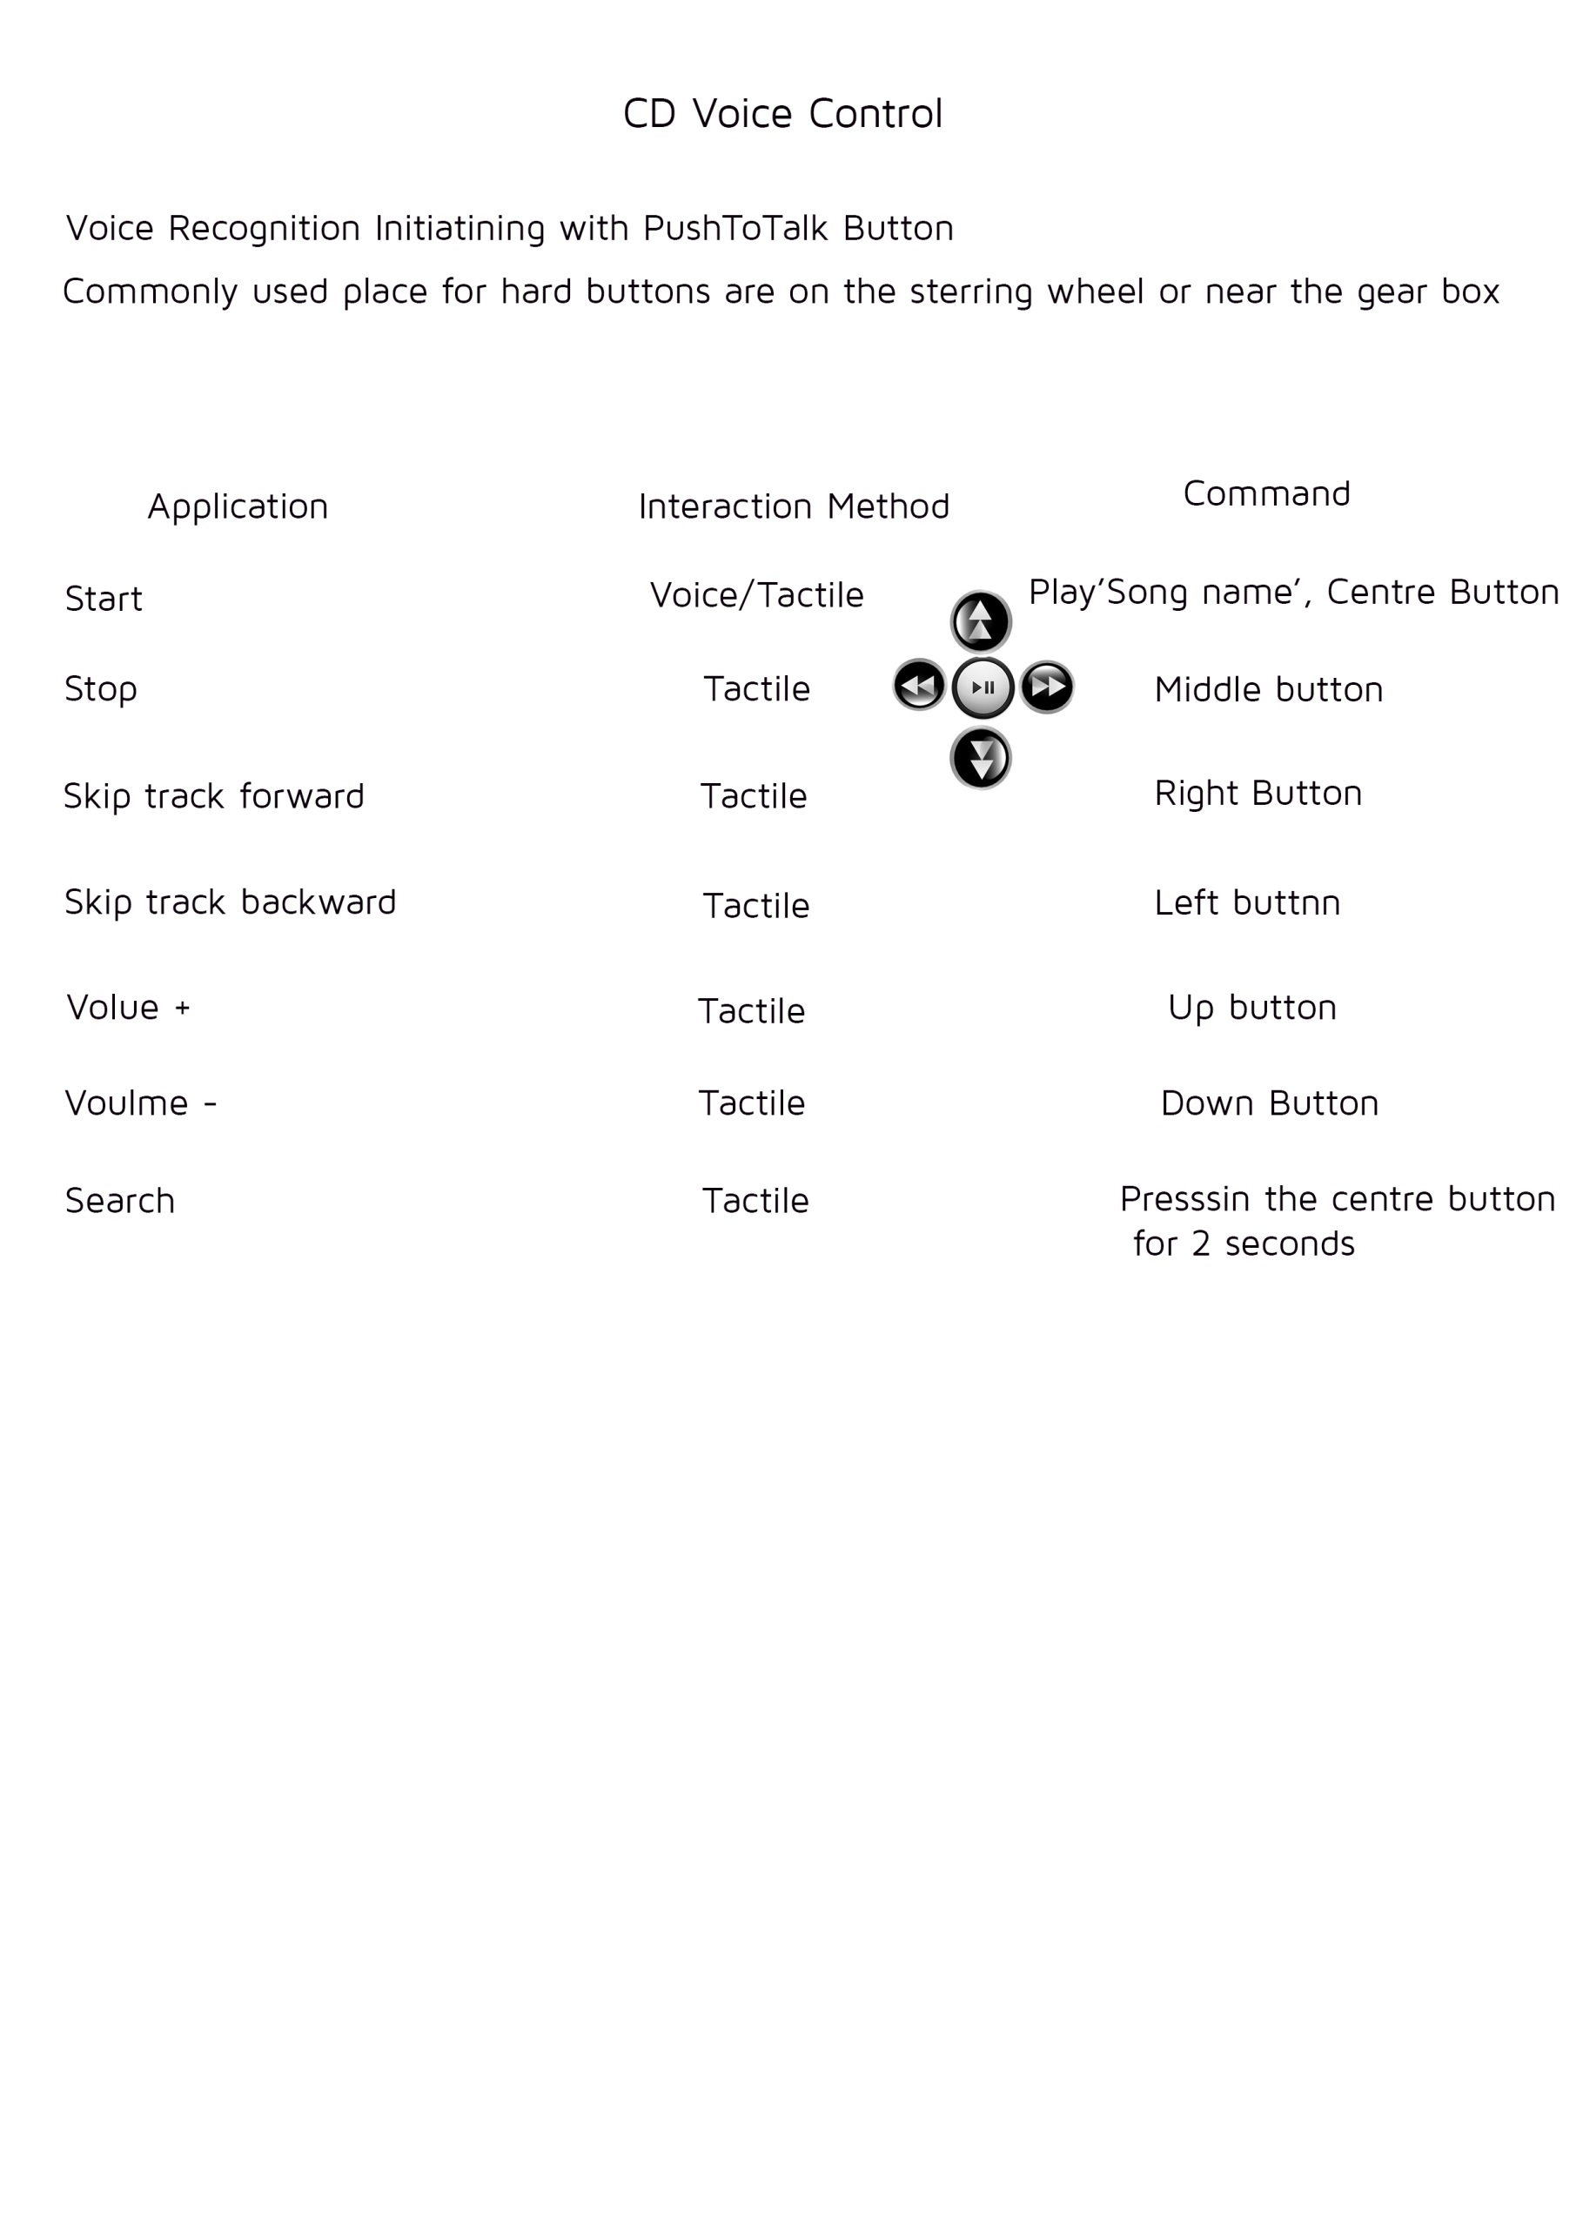

Slide 6
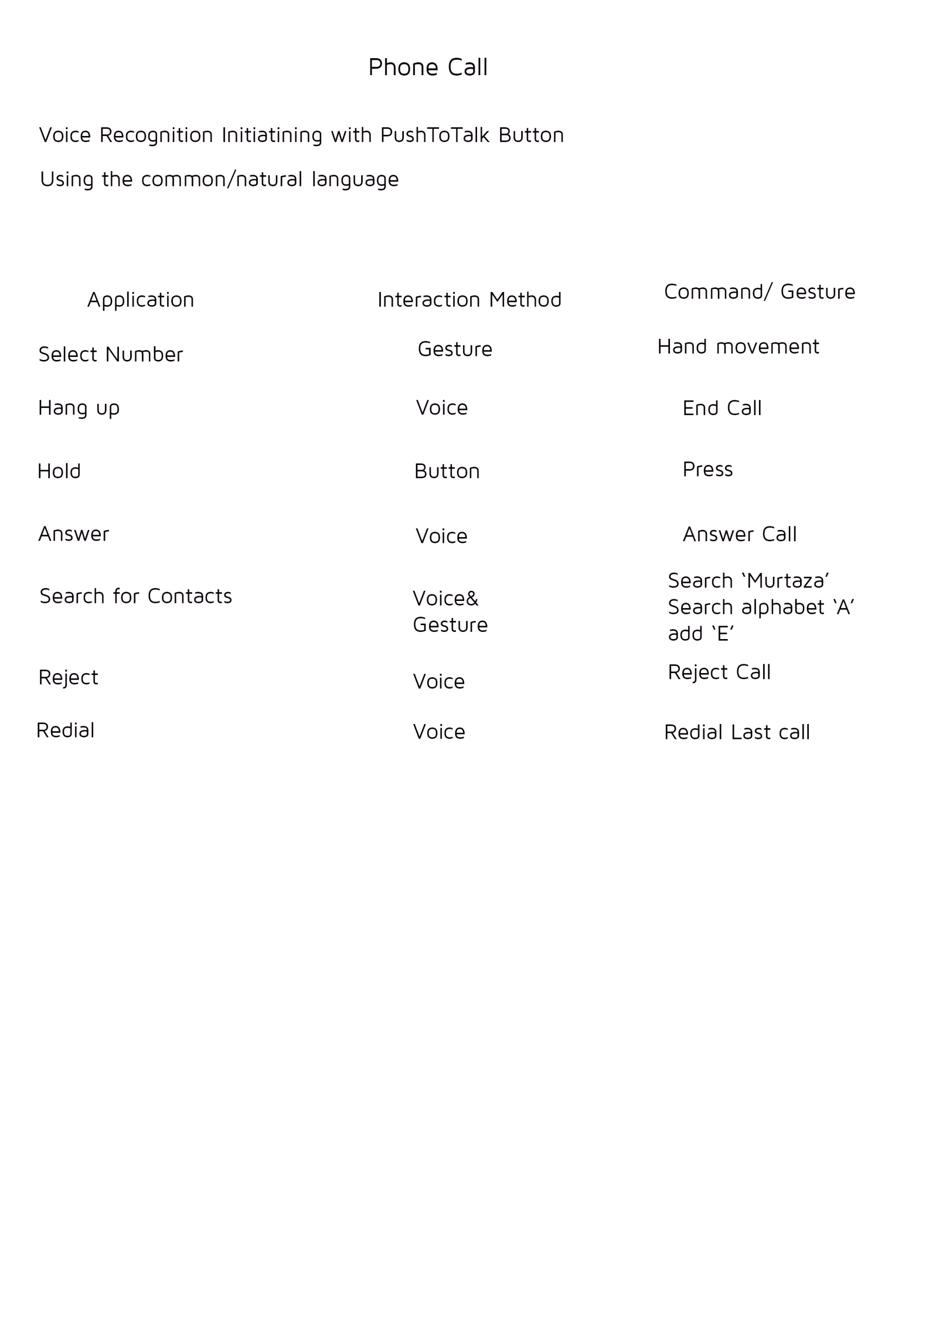

Slide 7
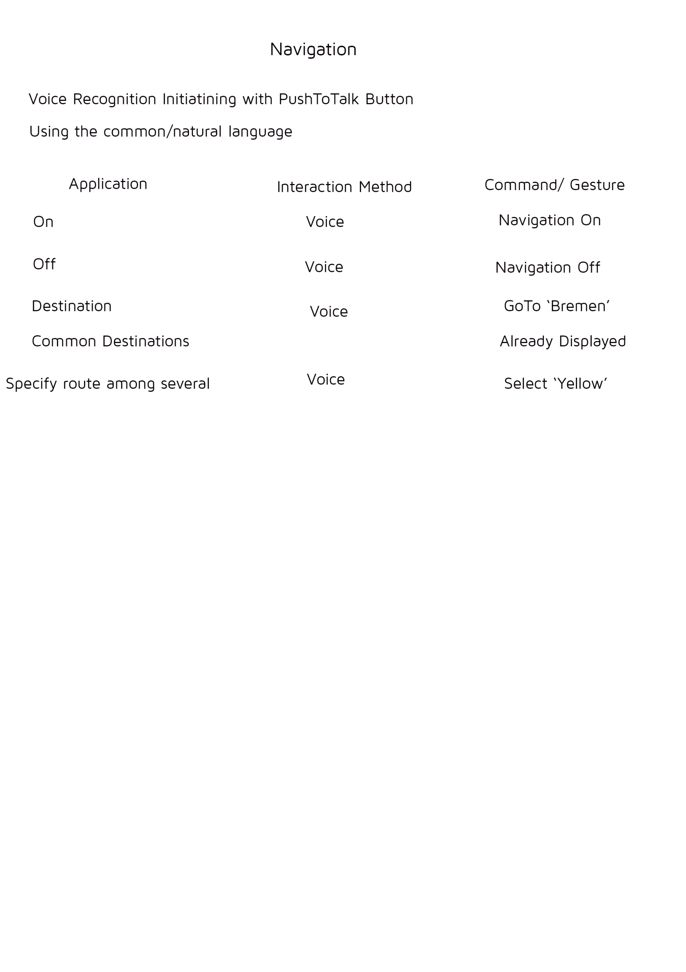

Slide 8
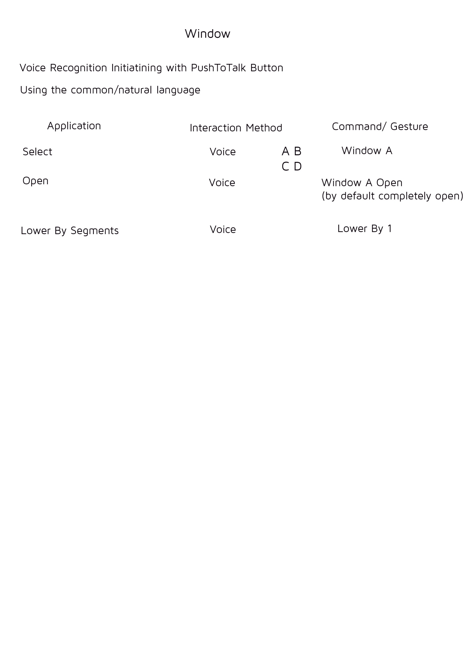

Slide 9
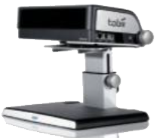
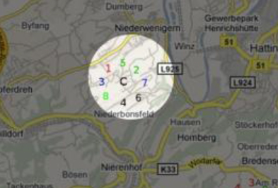
Gazemarks
Detect when the user switches
attention between displays
Save last gaze position when
the user “leaves” the screen
On “returning” to display
visualize the last gaze position

Slide 10
Result
Participants were considerably (about 3 times) faster in searching with Gazemarks
– with Gazemarks: 625.75 ms (median)
– without Gazemarks :1999.50 ms (median)
Qualitative results
– Preferences for Gazemark
– Mean value 4.26, standard deviation 0.53, on a scale from
0 (completely senseless) to 5 (very sensible)
Reported benefits as perceived by the user: enabling rapid task switch and less attention required

Slide 11
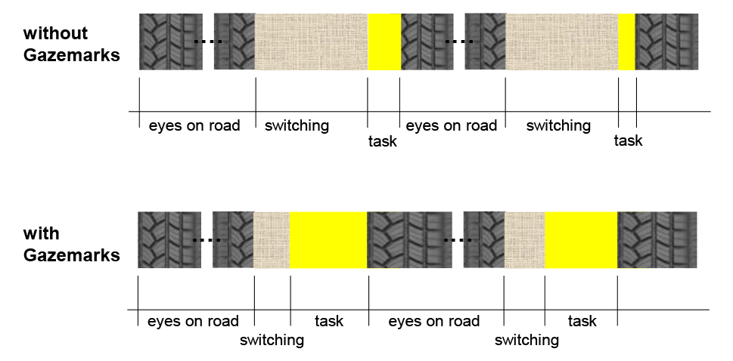
Enabling secondary tasks while driving

Slide 12
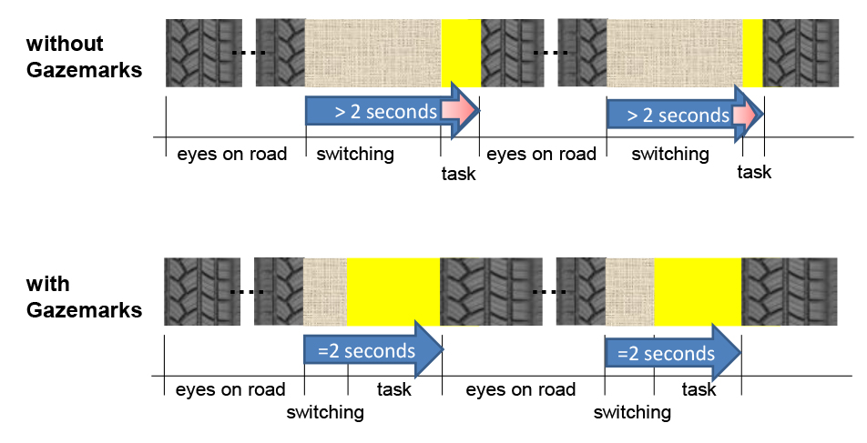
Secondary tasks while driving

Slide 13
Thank YOu

