Slide 1
Unity
Master Project Preparation
Murtaza Hussain

Slide 2
Unity (also called Unity3D) is a cross-platform game engine with a built-in IDE developed by Unity Technologies. It is used to develop video games for web plugins, desktop platforms, consoles and mobile devices.
Development, Testing, and deployment tool for your game.

Slide 3




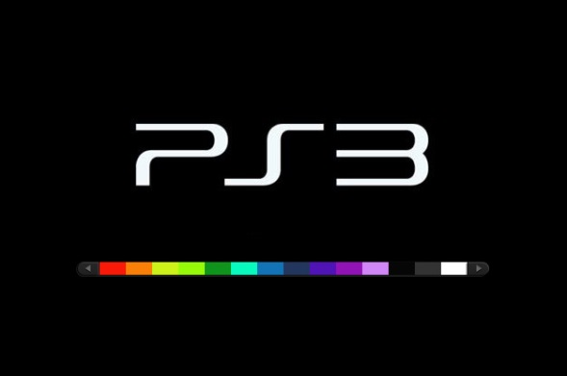


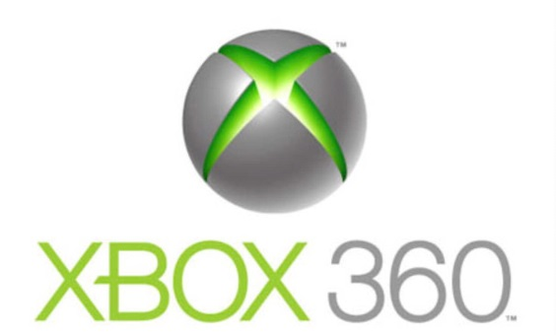

Multi platform Deployment

Slide 4
Scripting Language
Unity Script (same as JavaScript but with but bunch of features)
C# ( C# runs significantly faster than the other options and has the benefit of accessing all the .NET libraries for C#)
Boo

Slide 5
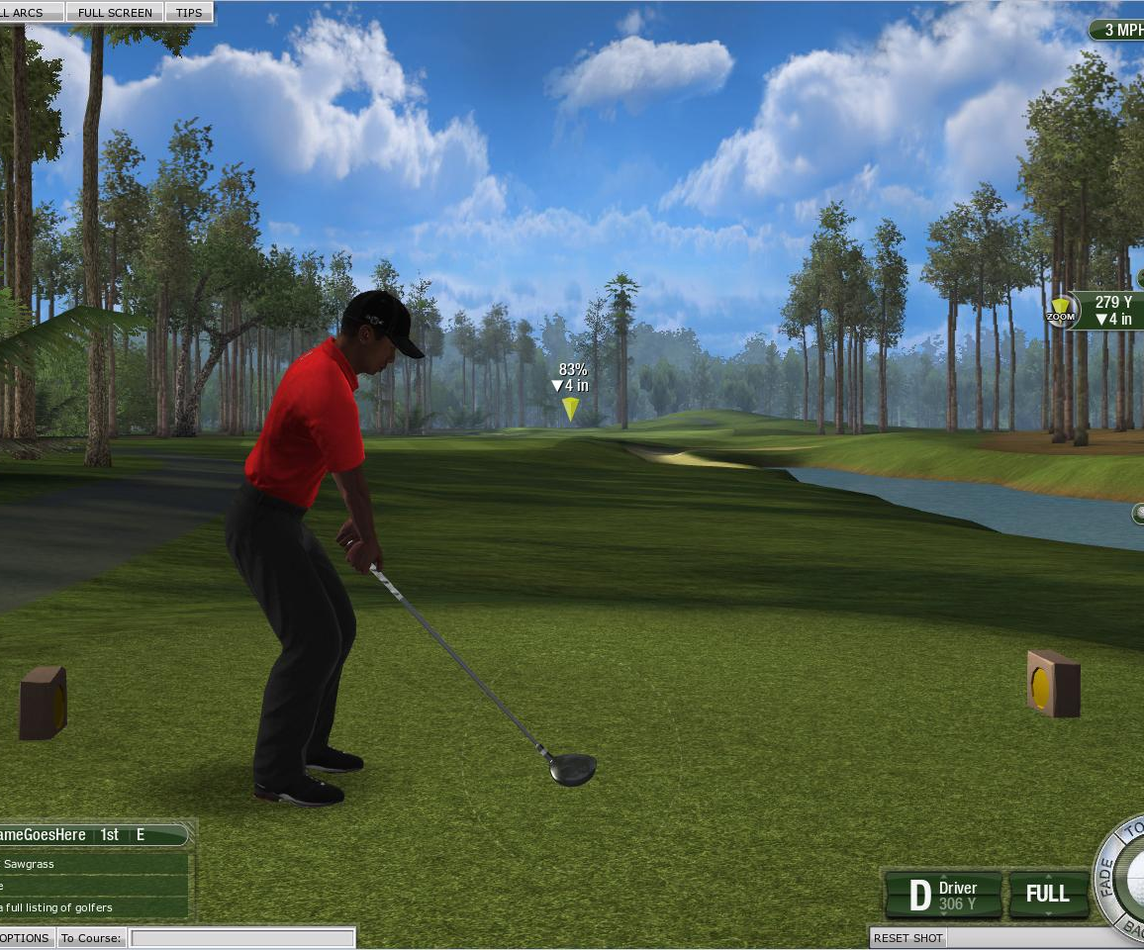
What kind of games can be written in Unity3D?
Side Scrolling Games
FPS
3rd Person Shooters
RPG
MMORPG(Massively Multi-
player online RPG)
Racing
Sports
Anything!!!

Slide 6
the 3d world view
Unity (like all similar engines) is an editor
Unity has a run-time viewer (like Game Salad) to preview all operations
Unity imports a wide variety of assets and allows the designer to place these in a 3d world view (also 2d), give the assets attributes (physics, collisions, etc. etc) and move under real-time control

Slide 7
Features
Rendering
The graphics engine uses
Direct3D (Windows)
OpenGL (Mac, Windows, Linux)
OpenGL ES (Android, iOS)
and proprietary APIs (Wii)
It provides support for

Slide 8
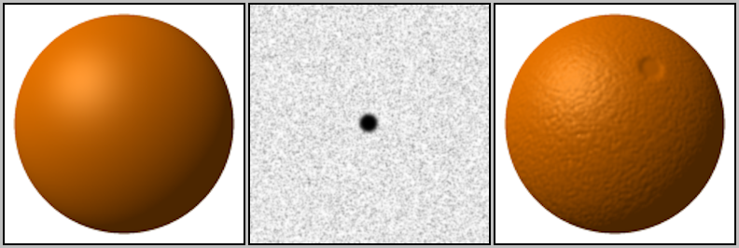
i. Bump Mapping
Bump mapping is a technique for simulating bumps and wrinkles on the surface of an object.
A sphere without bump mapping (left). A bump map to be applied to the sphere (middle). The sphere with the bump map applied (right) appears to have a mottled surface resembling an orange.

Slide 9
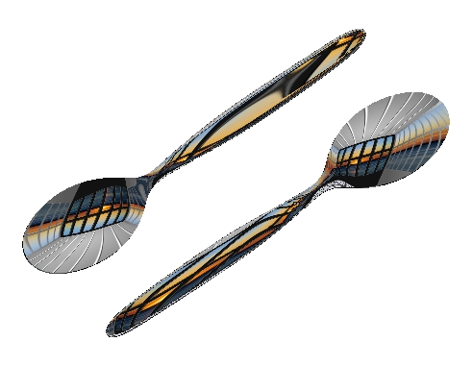
ii. Reflection mapping
Environment mapping, or reflection mapping, is an efficient image-based lighting technique for approximating the appearance of a reflective surface
The texture is used to
store the image of the
distant environment
surrounding the
rendered
object.

Slide 10
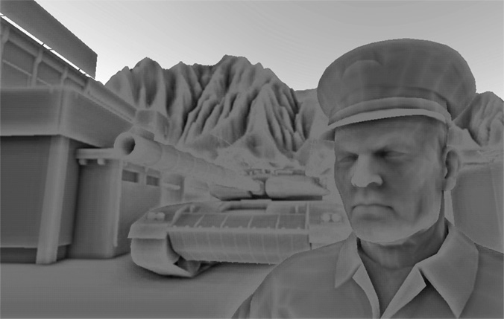
iv. Parallax mapping
v. Screen space ambient occlusion
a rendering technique for efficiently approximating the way light radiates in real life, especially off what are normally considered non-reflective surfaces.

Slide 11
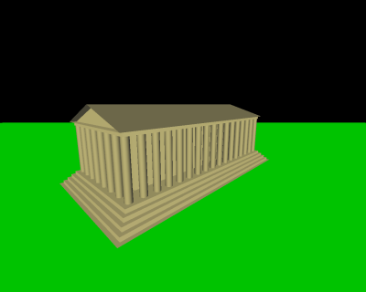
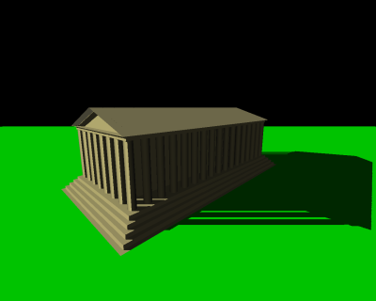
vi. Dynamic shadows
Scene with no shadows Scene with shadow mapping

Slide 12
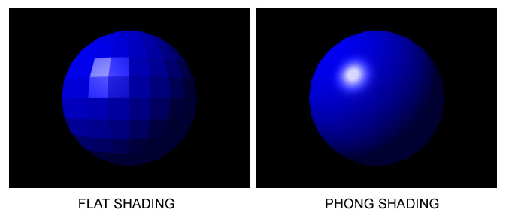
vii. Shading
The ShaderLab language is used for shading
Shaders are most commonly used to produce lighting and shadow in 3D modeling.

Slide 13

Shaders can also be used for special effects

Slide 14
Supported file formats
3ds Max, Maya , Softimage , Blender , modo , Zbrush , Cinema 4D , Cheetah3D , Adobe Photoshop , Adobe Fireworks
  For all due to .obj extension that can be nearly loaded into any other software
These assets can be added to the game project, and managed through Unity's graphical user interface.

Slide 15
Unity Basic VS Unity Pro
http://unity3d.com/unity/licenses

Slide 16
Community
Unity 3d has a mass support and community
I didn’t found any issues of Unity 3d with Kinect while surfing the community
While reading blogs I found people comments that claims Unity 3d is easy to learn as compared to UDK.
  Never the less if we have to work we have to learn

Slide 17
Asset Store
The store consists of a collection of over 4,400 asset packages, including 3D models, textures and materials, particle systems, music and sound effects, tutorials and projects, scripting packages, editor extensions and online services.

Slide 18
PRICE
Unity is free for the basic version, and $1500 for the professional version. Unity iPhone and Unity Android, which allow you to publish to iPhone and Android platforms, costs $400 each. Licenses for Wii, XBOX 360, or PS3 are separately sold; they cost a few thousand dollars.

Slide 19
Some Points to Consider
Unity doesn’t have Matinee. It doesn’t have Kismet. It doesn’t have an Animtree editor. It doesn’t have Scaleform, unless you’re willing to pay a $200 license for that and a $1500 license for Unity Pro (yes, compatibility with third-party plugins is one of the things they hold back). It doesn’t even support animated particles out of the box unless you script that by hand yourself.

Slide 20
Comp b/w Unity and UDK (Good one )
http://infinitewrench.wordpress.com/2012/09/07/unity3d-vs-unreal-development-kit/

Slide 21
Different Game Engines Comparison
http://www.esenthel.com/?id=compare

Slide 22
One More Word
I think so it doesn't matter what software or platform we use. The only thing that matters is what can we do with it. If we have a clear vision of a project, we will manage to do it with any engine.

