Slide 1
Scene Modeling
In 3DMAX

Slide 2

3DMAX
Autodesk 3ds Max, formerly 3D Studio Max, is 3D computer graphics software for making 3D animations, models, and images. It was developed and produced by Autodesk Media and Entertainment. It has modeling capabilities, a flexible plugin architecture and can be used on the Microsoft Windows platform. It is frequently used by video game developers, TV commercial studios and architectural visualization studios. It is also used for movie effects and movie pre-visualization.
3ds Max is an application for creating virtual three-dimensional objects. The application's variety of tools makes several approaches for modelling a given object possible.

Slide 3
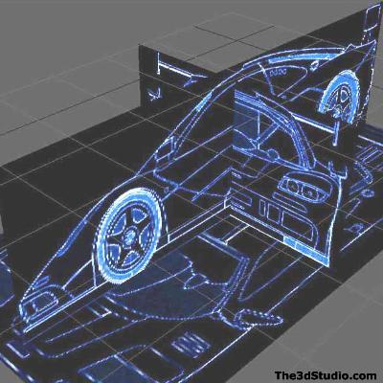
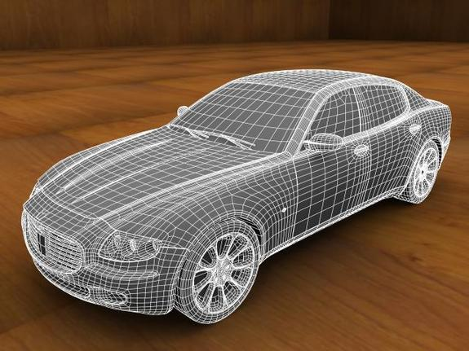
some guidelines pertain to all strategies for modelling complex objects, such as car interiors. One of the most helpful is "divide and conquer." Break up the complex object into simpler components; build the individual components, then assemble them to form the complete object.

Slide 4
Output format
EXPORT:
3D Studio (.3DS)
Adobe Illustrator (*.AI)
ASCII Scene Export (*.ASE)
Lightscape - Material (*.ATR), Blocks (*.BLK), Parameter (*.DF), Layers (*.LAY), Preparation (*.LP), View (*.VW)
Autodesk DWF (*.DWF)
Autocad DWG (*.DWG)
Autocad DXF (*.DXF)
Autodesk FBX (*.FBX, *.DAE)
Motion Analysis HTR File (*.HTR)
IGES (*.IGS)
JSR-184 (*.M3G)
Wavefront Object (*.OBJ) and Material (*.MTL)
StereoLitho (*.STL)
Shockwave 3D (*.W3D)
VRML97 (*.WRL)
http://wiki.cgsociety.org/index.php/3ds_Max_File_Formats

Slide 5
A Real Time 3D Game Engine for 3DMAX
Althiar Stage Director is a 3D game engine that can be plugged into 3DS Max in order to test and edit in real-time scenes and models. Althiar Stage Director powers an instantaneous 3D game-view of the scene being created, allowing users to visualize, explore and evaluate the most complex scenes and the most advanced effects.

Slide 6
Game engine in Blender
The game engine in particular is an incredible feature. It allows interactive game creation with user input, a real physics model, (same one used on the play station) collision-detection, and projectiles, all without programming. When you're ready to make the jump to programming, Blender integrates the entire Python language (not a subset) so you can do anything you can do with Python, including networking and other sophisticated modules.
http://peach.blender.org/
http://www.yofrankie.org/

Slide 7
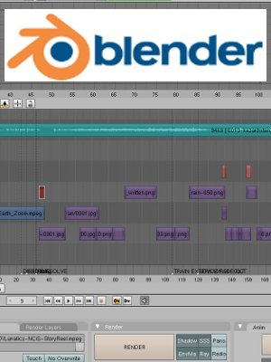
Video Editor in Blender
Blender also includes a workable non-linear video editor, which allows you to build movies directly within blender without having to jump to another app. It supports most kinds of transitions and other basic effects you'd expect in a simple video editor.

Slide 8
Thanks for your time ☺

