Slide 1
Segmentation-Free, Area-Based Articulated Object Tracking
Daniel Mohr, Gabriel Zachmann Clausthal University, Germany {dmoh,zach}@tu-clausthal.de
ISVC 2011, Las Vegas, Nevada, USA
Notes:
assume
gestures
approach

Slide 2
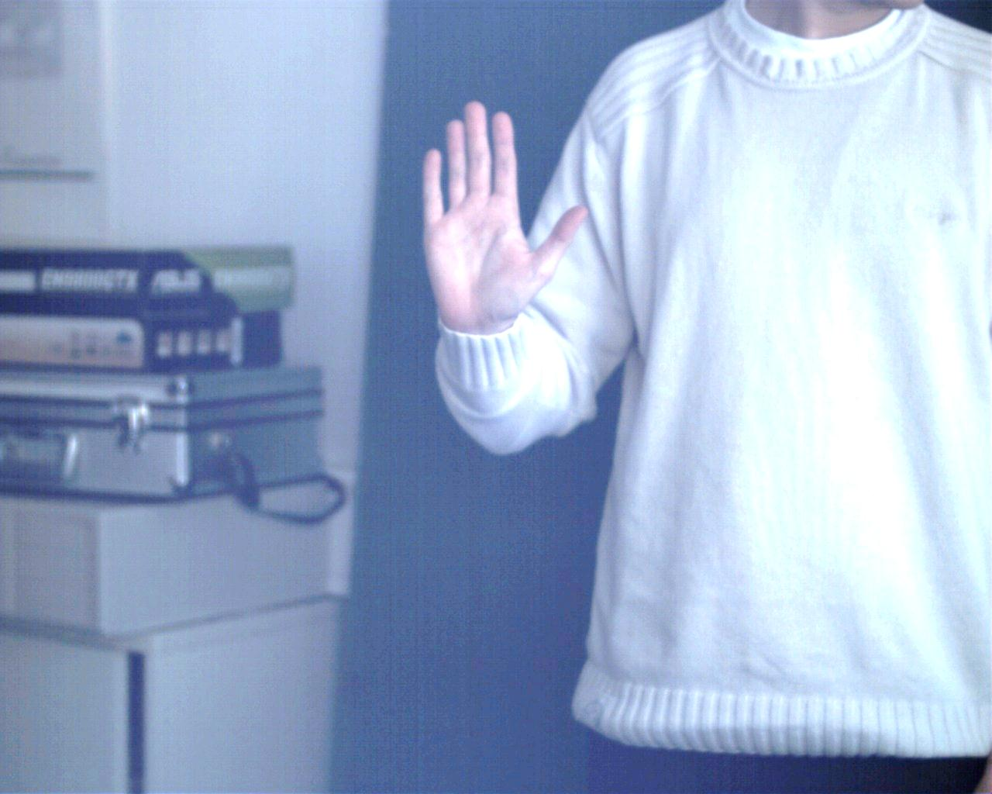
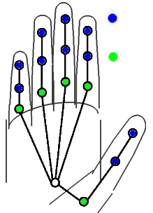
Motivation: Camera Based Hand Tracking
Estimate hand parameter
Global position (3 DOF)
Global orientation (3 DOF)
Joint angles (20 DOF)
Tracking approach
Sample hand parameter space
Render hand model for
Compute descriptor for matching
1 DOF
2 DOF
global state
local state
Introduction Related Work Similarity Measure Poste Estimation Results Conclusions & Future Work
Notes:
Our motivation is the camera based hand tracking.
Given an input image, we want to estimate
--
\theta_1, \cdots, \theta_N, ~~~\theta_i \in \mathbb{R}^{26}
--
M\! \ll \! N

Slide 3
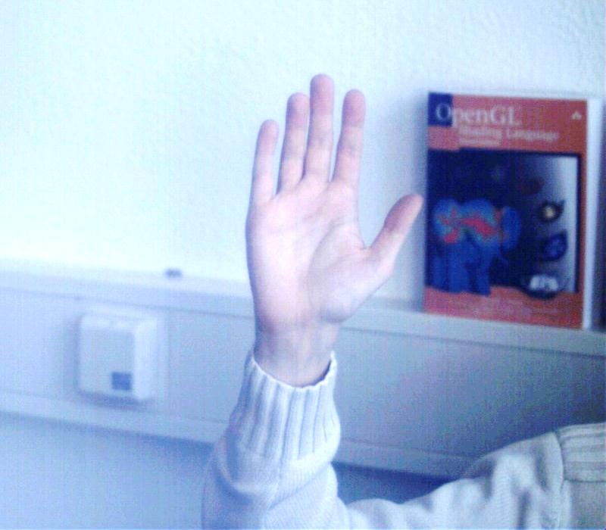
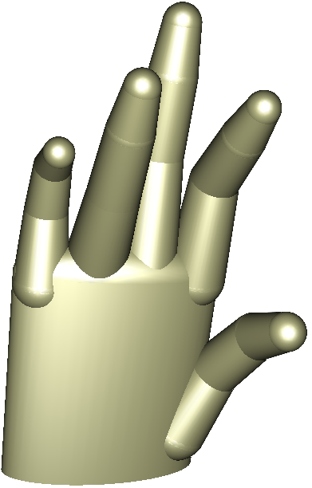
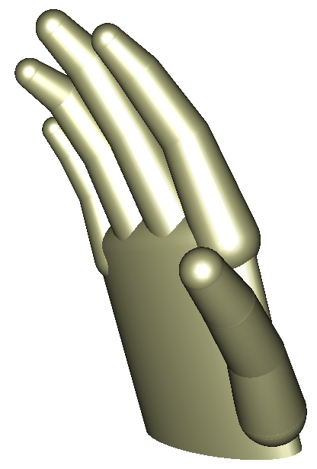
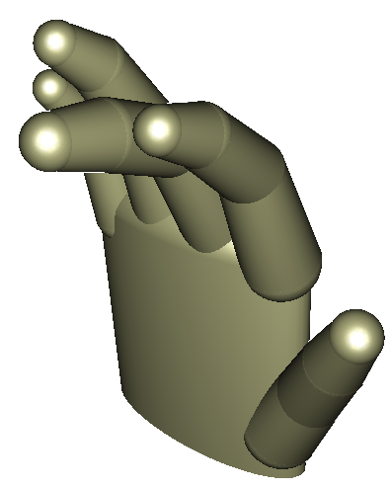
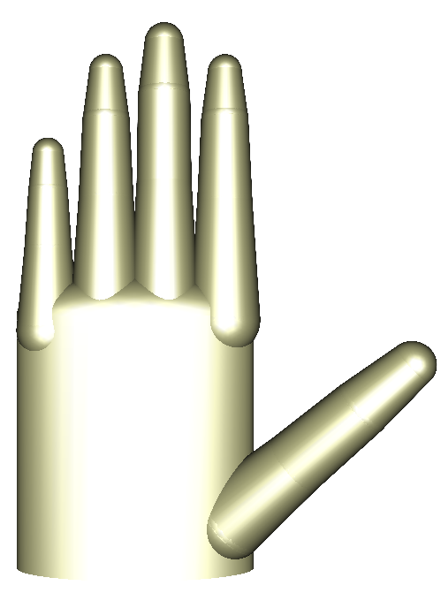
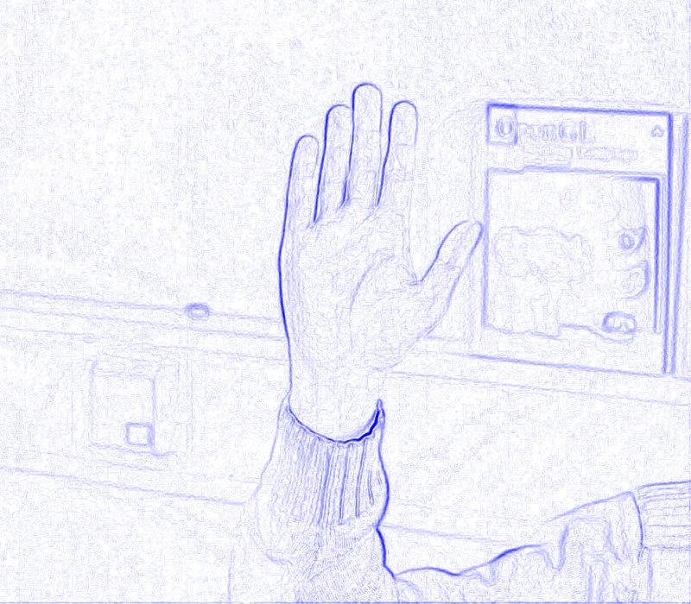
Related Work
Conventional Tracking Pipeline
Binary Segmentation
Compare difference vectors between gravity center and points at binary silhouette contour [Imai et. al AFGR ‘04][Shimada et. al ICCV ‘01]
Intersection between template and segmentation [Lin et. al AFGR ‘04][Kato et. al AFGR ‘06][Ouhaddi et. al ‘99]
Segmentation likelihood
Joint probability using skin likelihood map [Stenger et. al PAMI ‘06][Sudderth et. al CVPR ‘04]
Capture image
Feature extraction
Binarization
Matching
Result
Skin segmentation
Edge detection
Sources of error
Introduction Related Work Similarity Measure Poste Estimation Results Conclusions & Future Work
Introduction Related Work Similarity Measure Poste Estimation Results Conclusions & Future Work
Notes:
Now, what do we mean with segmentation-free tracking.
To explain this, I first want to give a short overview of

Slide 4
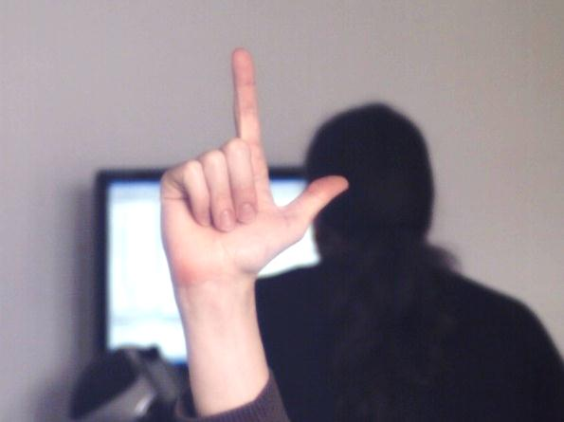
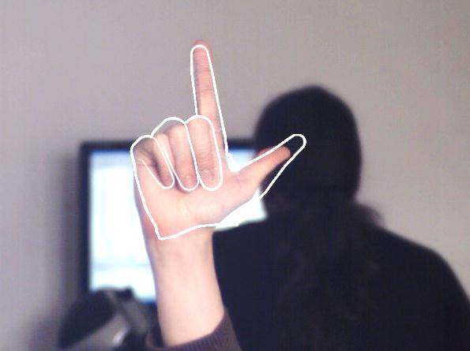
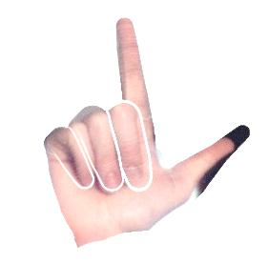
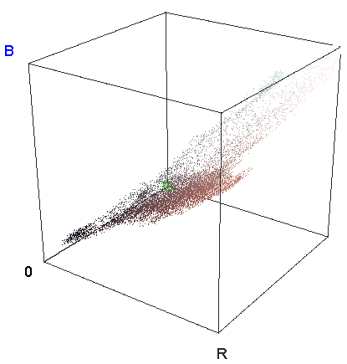
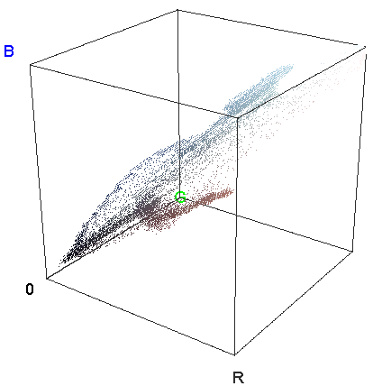
Our Color Divergence-Based Similarity
Input Image
Hypothesis about shape
Fore- and Background from Hypothesis
Check color distribution
Dissimilarity
Likelihood
Introduction Related Work Similarity Measure Poste Estimation Results Conclusions & Future Work

Slide 5
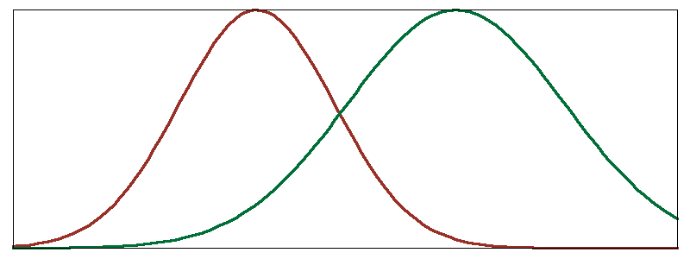
Dissimilarity Measure
Goal: compute extremely fast
Gaussian distribution for foreground color:- and background color:
Similarity =
Kullback-Leibler divergence for Gaussians performed worse
+
Introduction Related Work Similarity Measure Poste Estimation Results Conclusions & Future Work
Notes:
Because the sim-measure has to be evaluated for a large number of tpl and input positions it is crucial to compute it very fast…
---
\mu_{fg}, \Sigma_{fg}, \mu_{bg}, \Sigma_{bg}
---
G(\vc \mu_{bg}| \vc \mu_{fg},\Sigma_{fg})
---
G(\vc \mu_{fg}| \vc \mu_{bg},\Sigma_{bg})
---
GNUPLOT:
unset xtics
unset ytics
set terminal png transparent nocrop enhanced font arial 8 size 800,300
set output 'D:\Conferences\color-based_tpl_matching\ISVC_folien\bilder\divergence-of-gaussians.png'
plot [-10:20] exp( -0.5*(x-1)**2/(3.5**2) ) lw 3 lt rgb "#983027“ notitle, exp(-0.5*(x-10)**2/(4.9**2) ) lw 3 lt rgb "#006F37“ notitle
---

Slide 6
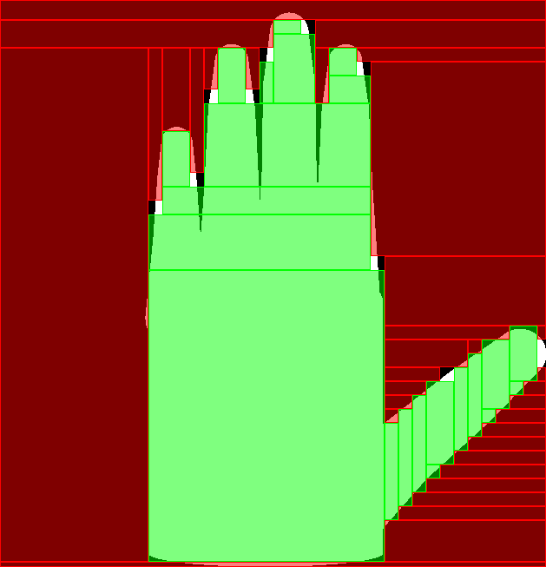
Our Fast Color Distribution Estimation
Color mean μ is normalizing sum of pixel colors
Color covariance matrix
For each channel in input image:
Compute integral image
For all templates:
Axis-aligned rectangle representation
Subdivide large rectangles
Introduction Related Work Similarity Measure Poste Estimation Results Conclusions & Future Work
Notes:
---
\begin{align*}
\Sigma & \propto \sum_{\vc x \in \mathcal{R}} \vc x \vc x\trp - \vc \mu \vc \mu\trp \\
&= \sum_{R_i \in \mathcal{R}} \sum_{\vc x \in R_i} \vc x \vc x\trp - \vc \mu \vc \mu\trp \\
&\approx \sum_{R_i \in \mathcal{R}} |R_i| \cdot \vc \mu_i \mu_i\trp - \vc \mu \vc \mu\trp
\end{align*}
---

Slide 7
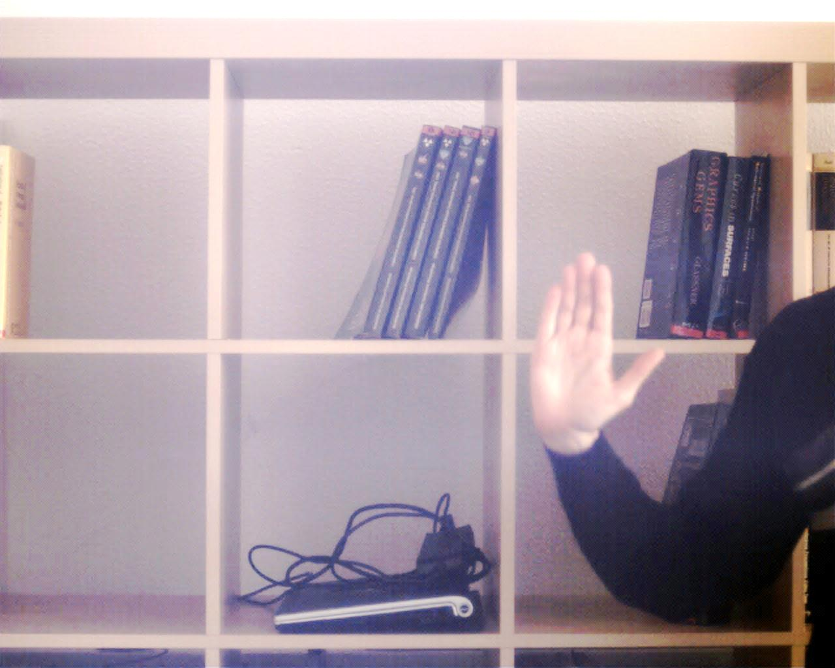
Tracking by Detection
Tracking by detection
No manual initialization
No predictive filtering
Predictive filtering tends to drift away
Real hand movements are unpredictable
For each frame:
find hand pose & position
find global max in likelihood map
Approach:
Scan input image with step size Δ and
Perform local optimization
Introduction Related Work Similarity Measure Poste Estimation Results Conclusions & Future Work
Notes:
We perform tracking itself also by detection
Also applicable for initialization of predictive approaches (manual init not desired or possible)
For the promising candidates

Slide 8
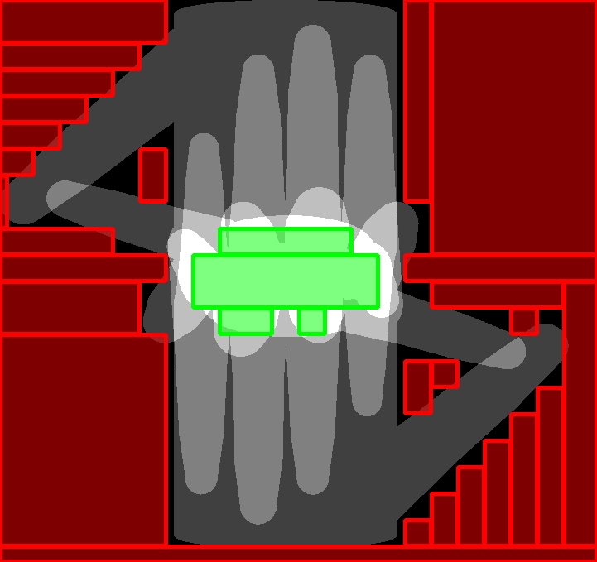
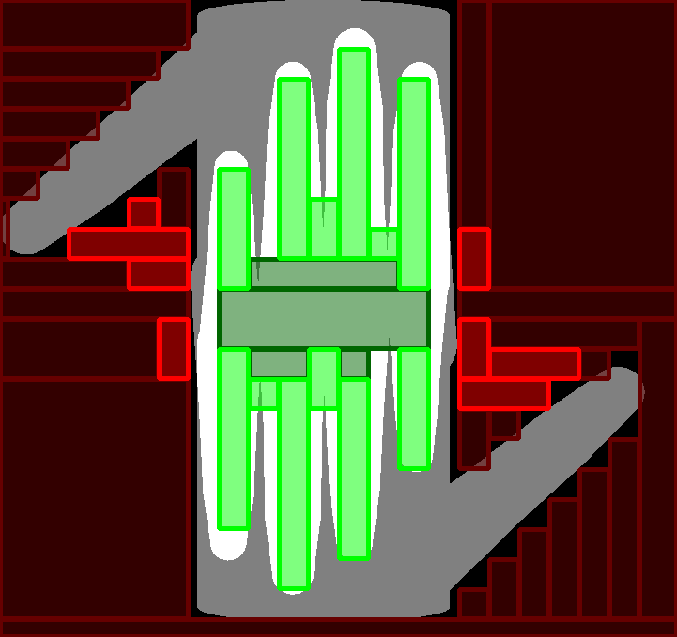
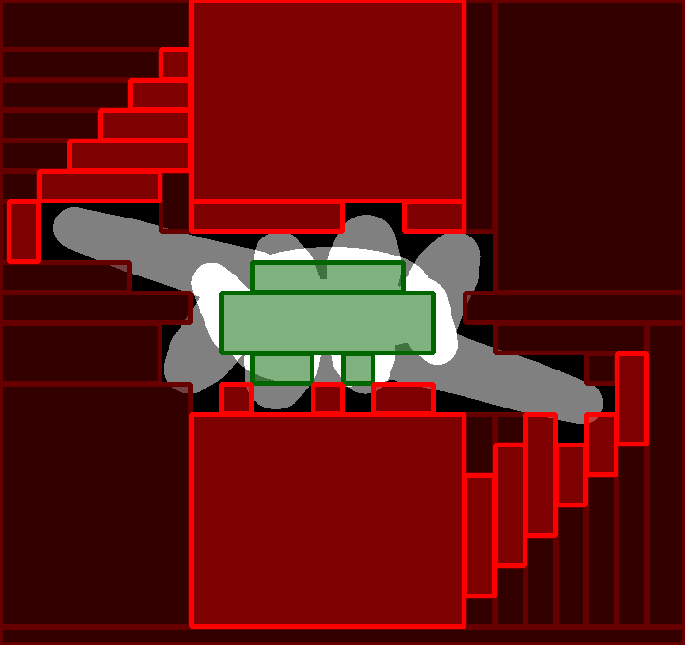
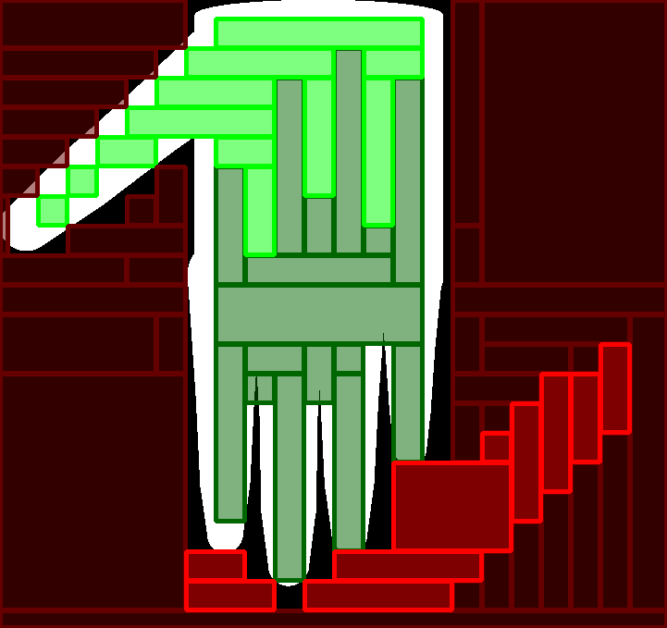
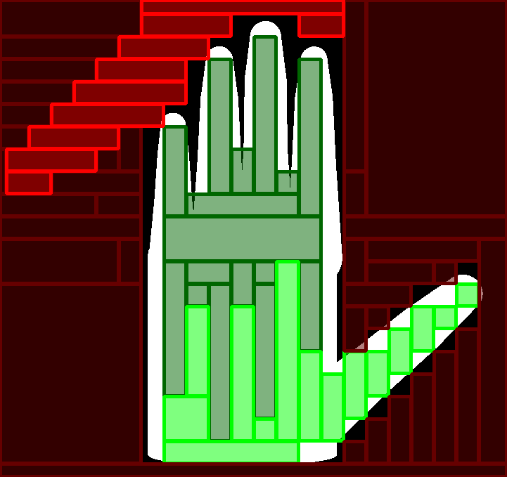
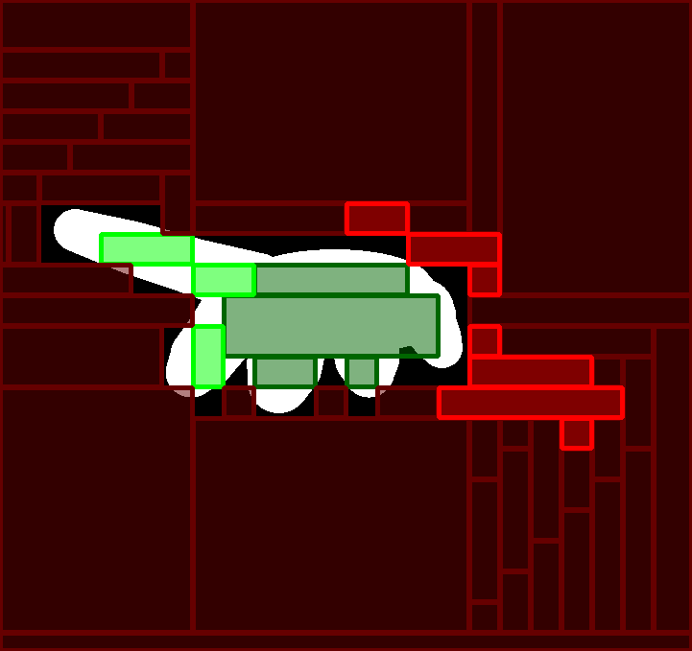
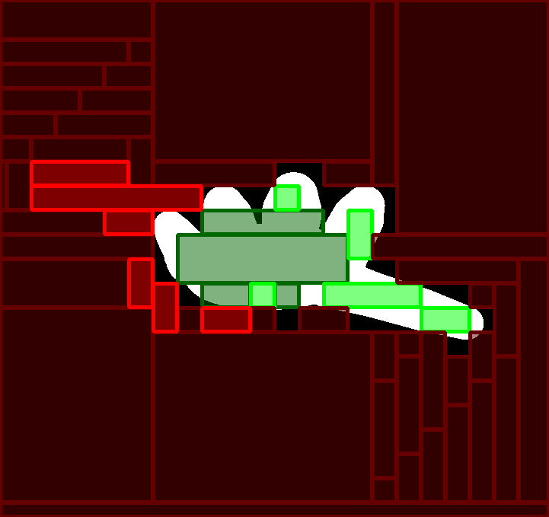
Determine Best Match from Object Database
Task: Find best of n hand poses
Hierarchy
Based on intersection
Complexity O(log n)
Introduction Related Work Similarity Measure Poste Estimation Results Conclusions & Future Work
Notes:
…because in practice, the database is too large
We use a hierarchy as acceleration datastructure

Slide 9
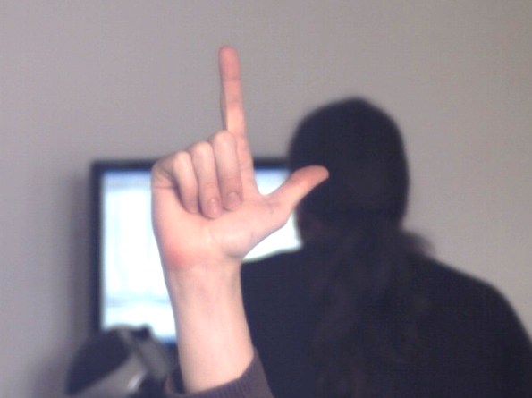
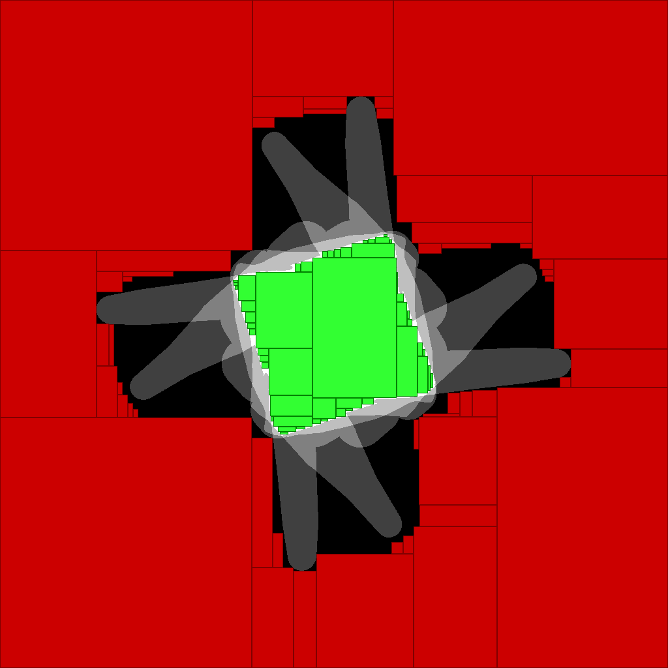
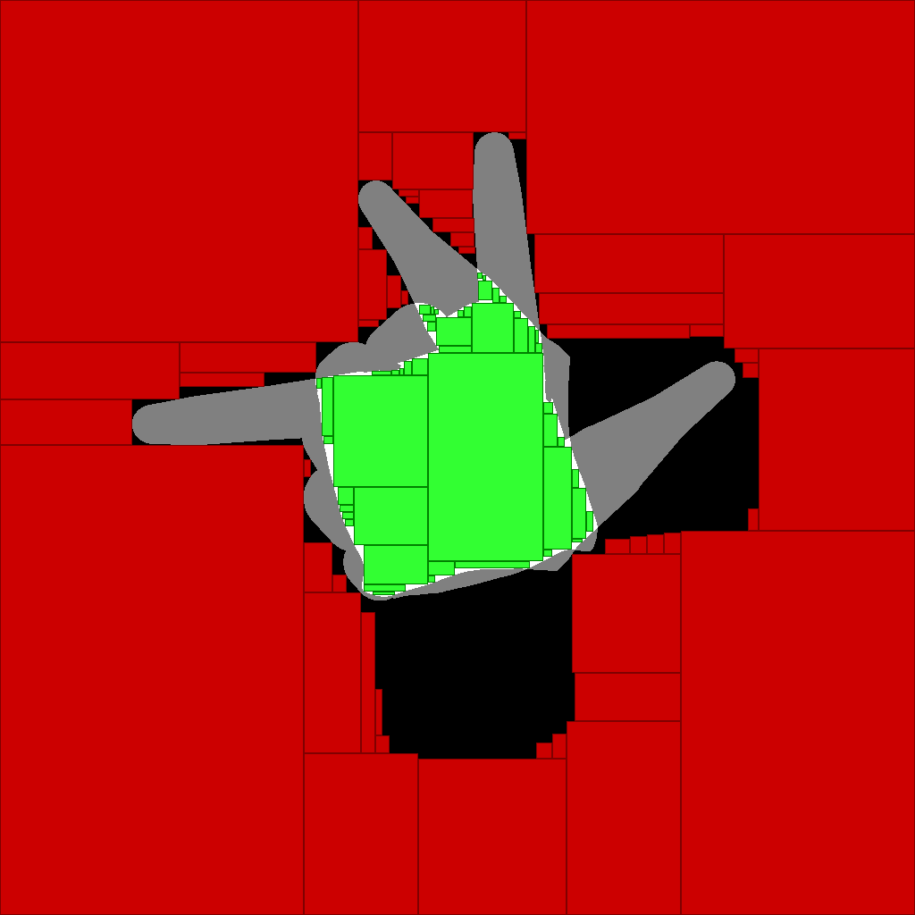
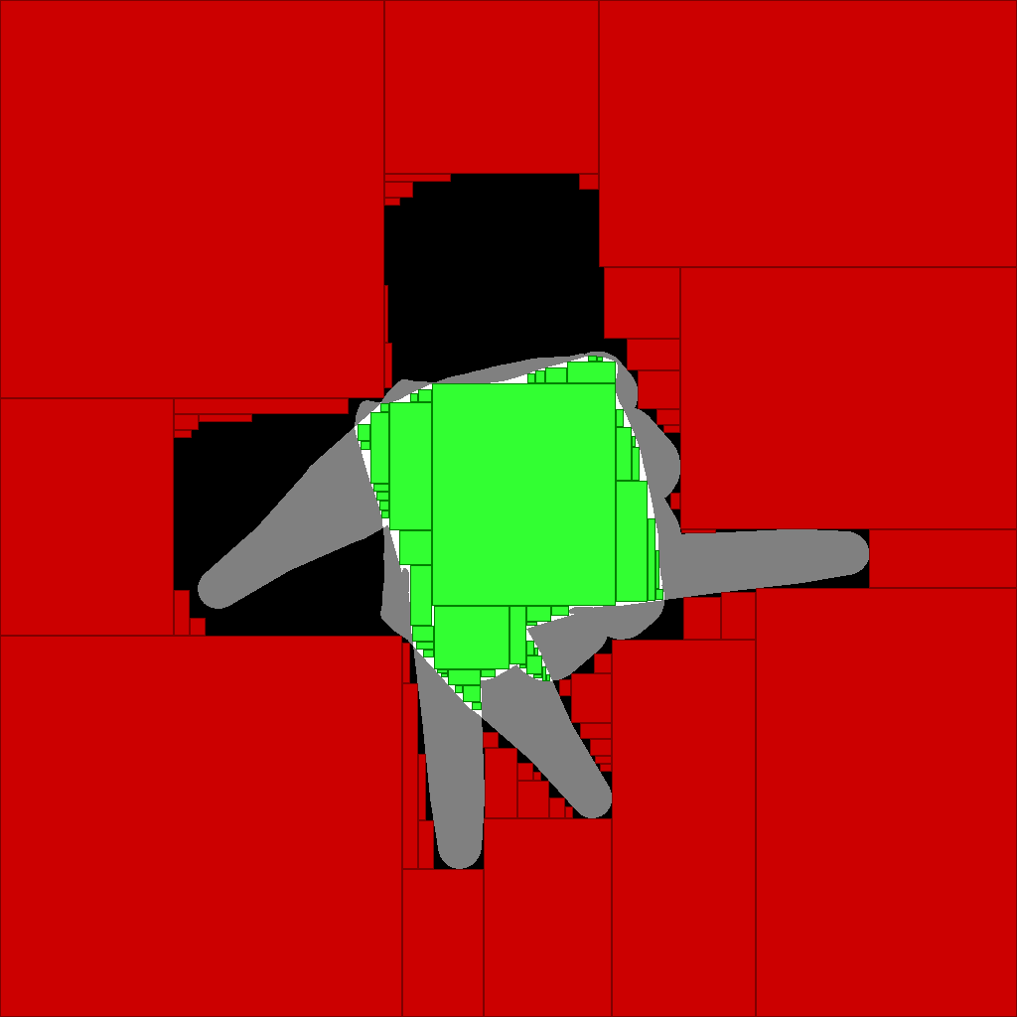
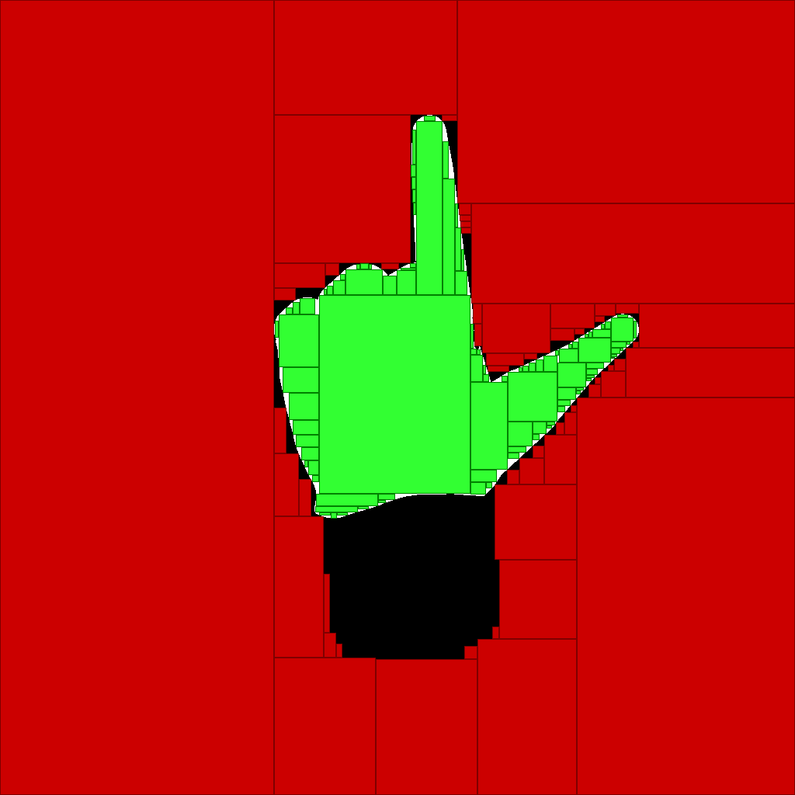
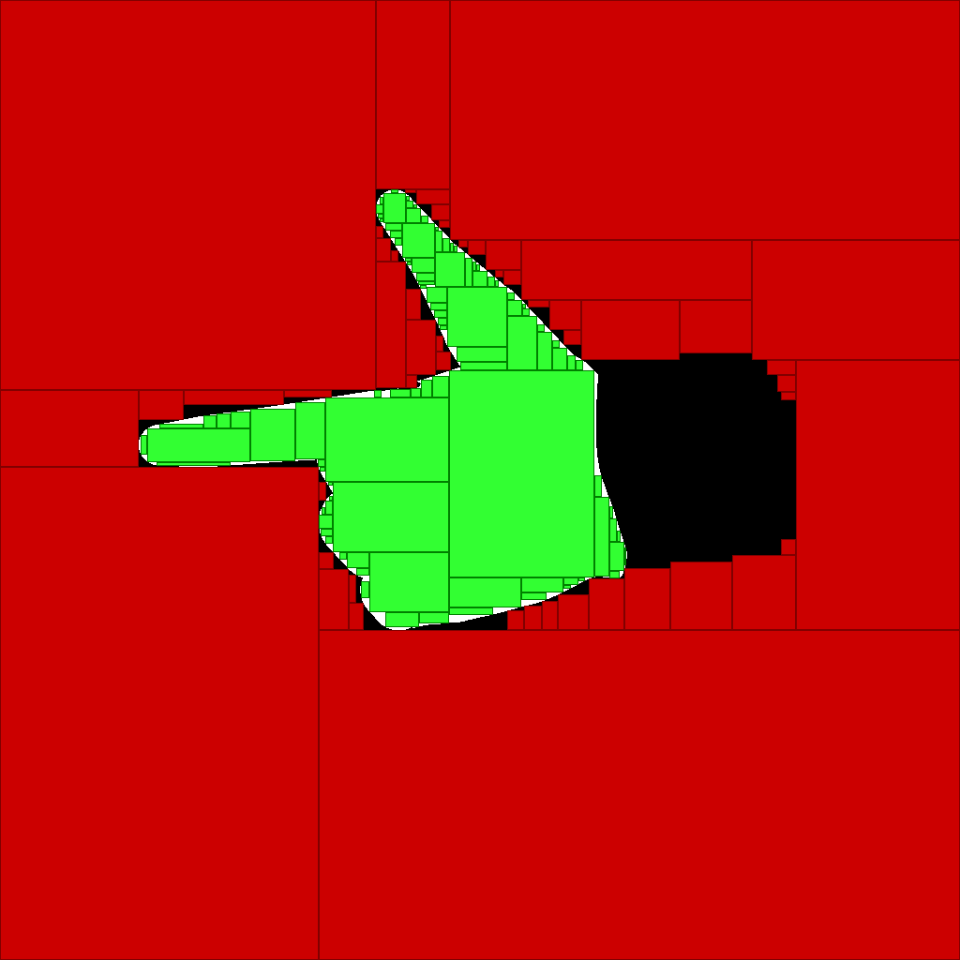
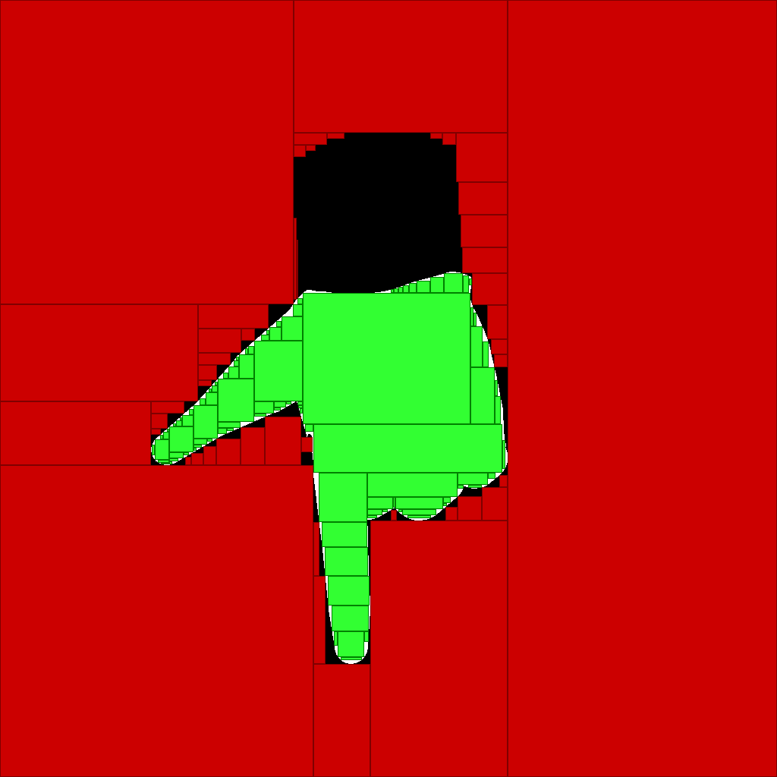
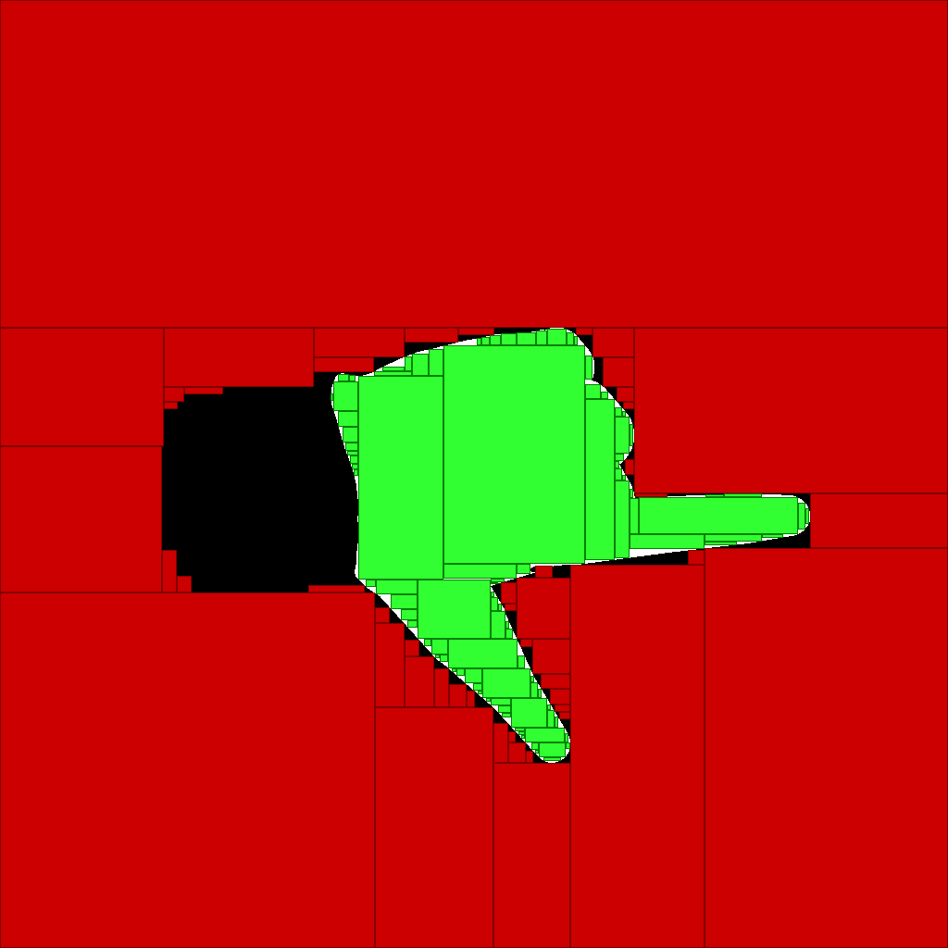
Our Hierarchical Coarse-to-Fine Detection
Input image
Template hierarchy
1
1
1
1
1
1
1
1
1
4
5
2
3
4
5
2
3
2
3
4
2
3
1
1
1
1
5
1
1
1
1
4
5
6
7
Algorithm
add match candidates
local optimization
keep k best candidates
for each candidate replace by child node
if inner nodes goto 2
else local optimization select best candidate
Introduction Related Work Similarity Measure Poste Estimation Results Conclusions & Future Work
Notes:
We combine the hierarchy with the local opt idea into the following algorithm…

Slide 10
Computation of Step Size Δ
Δ_{x}
Need to be computed offline at template generation
No knowledge about input image
Estimate based only on template silhouette
Idea
Consider likelihood map as a function
Sampling theorem: sample at least with 2 × highest freq.
What is the highest freq. ?
Intersection of template with itself
Autocorrelation of template
Δ_{y}
1
1
1
1
1
1
1
1
1
1
1
1
1
1
1
1
Δ_{y}
Δ_{x}
Introduction Related Work Similarity Measure Poste Estimation Results Conclusions & Future Work
Notes:
It is left to explain, how we compute the step size Δ, that determines the grid size

Slide 11
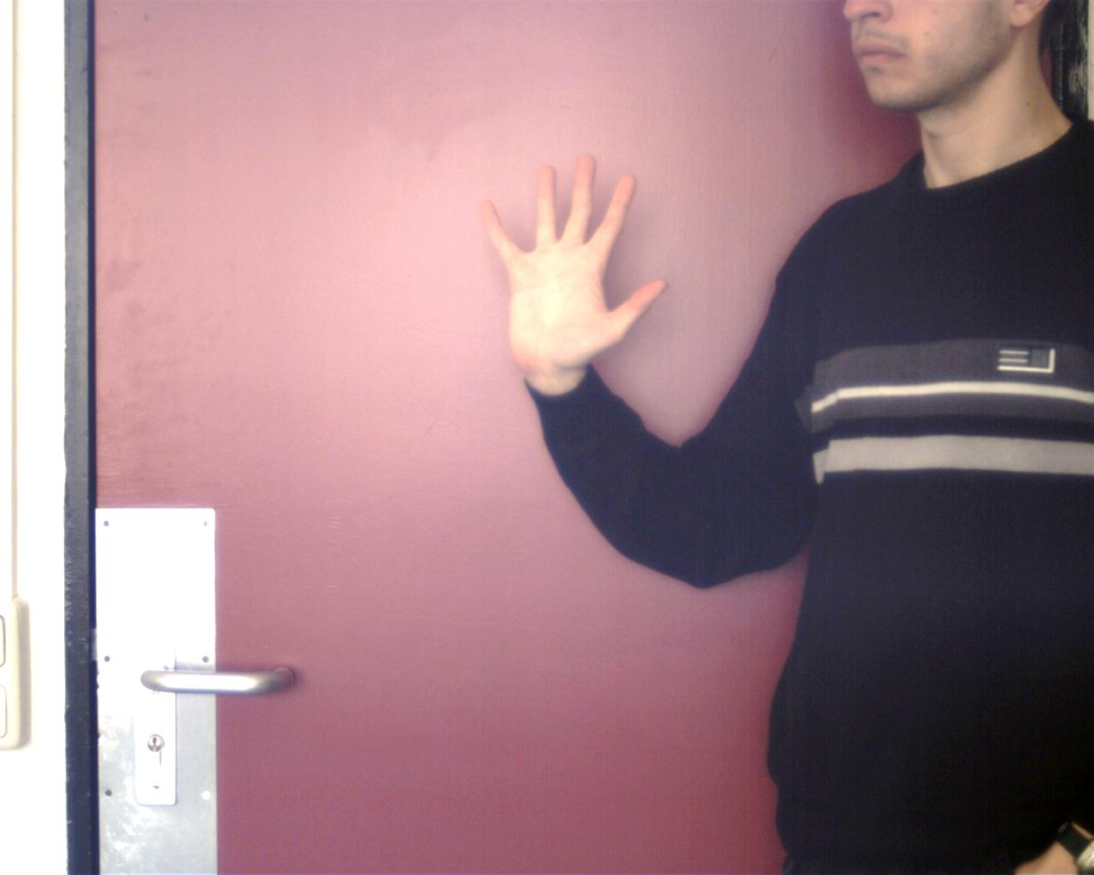
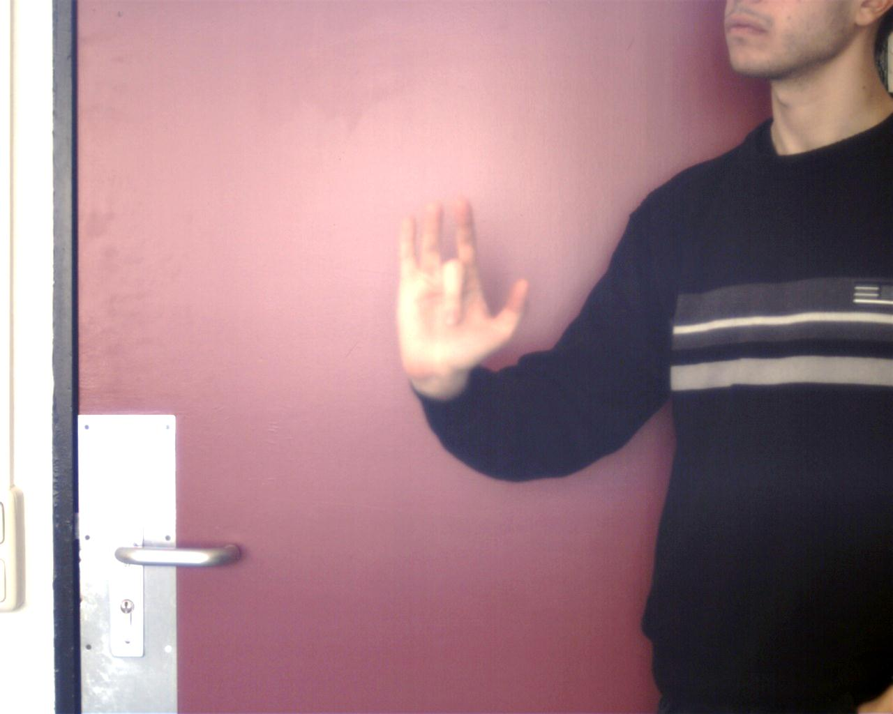
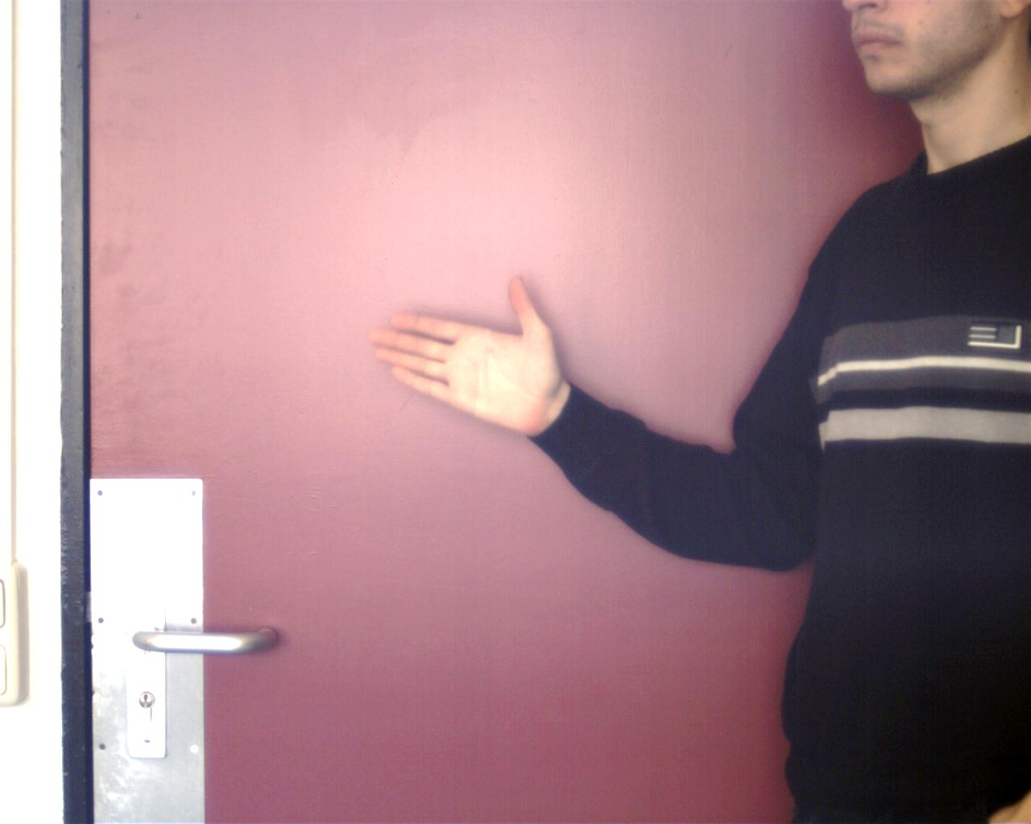
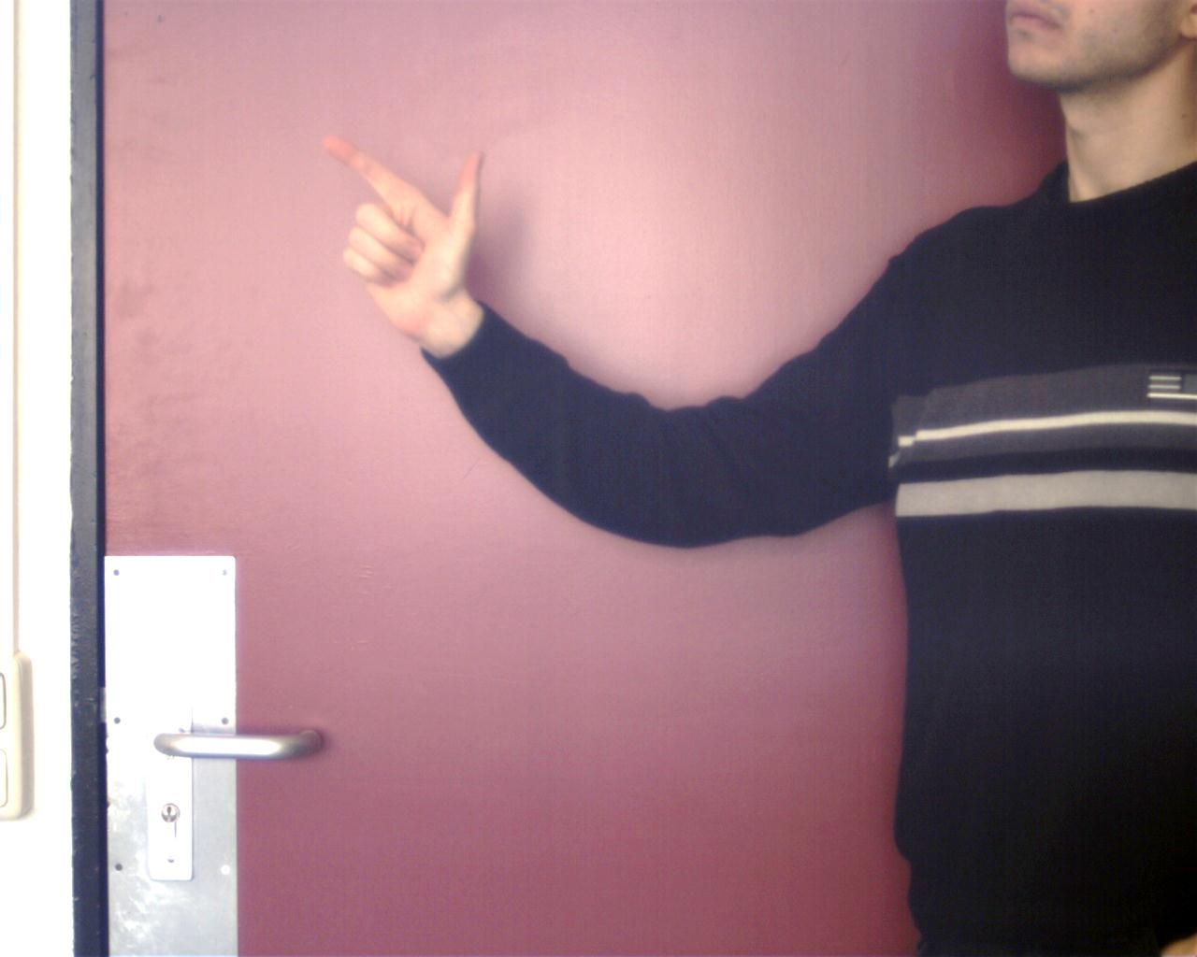
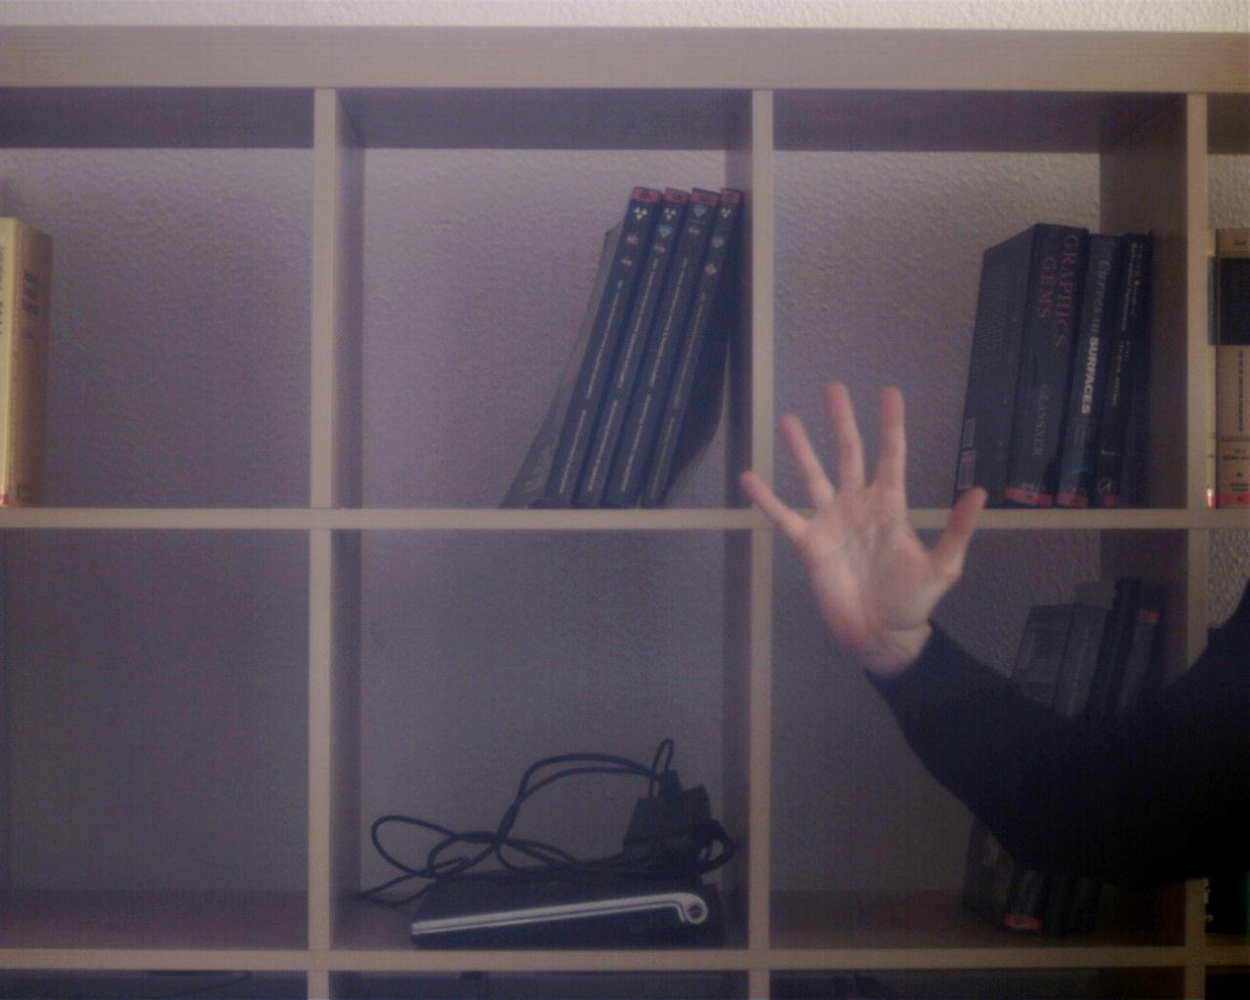
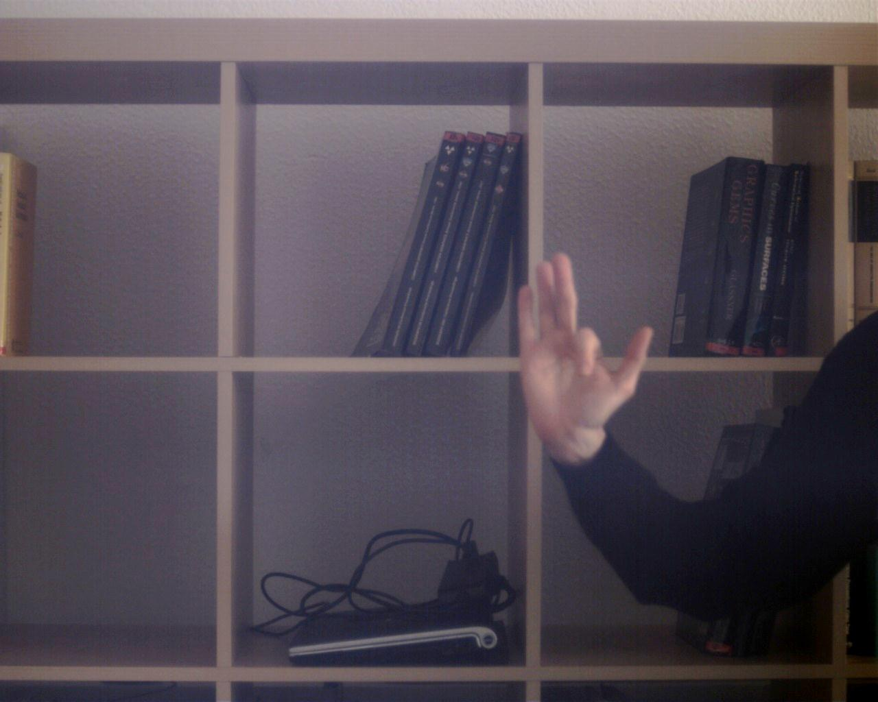
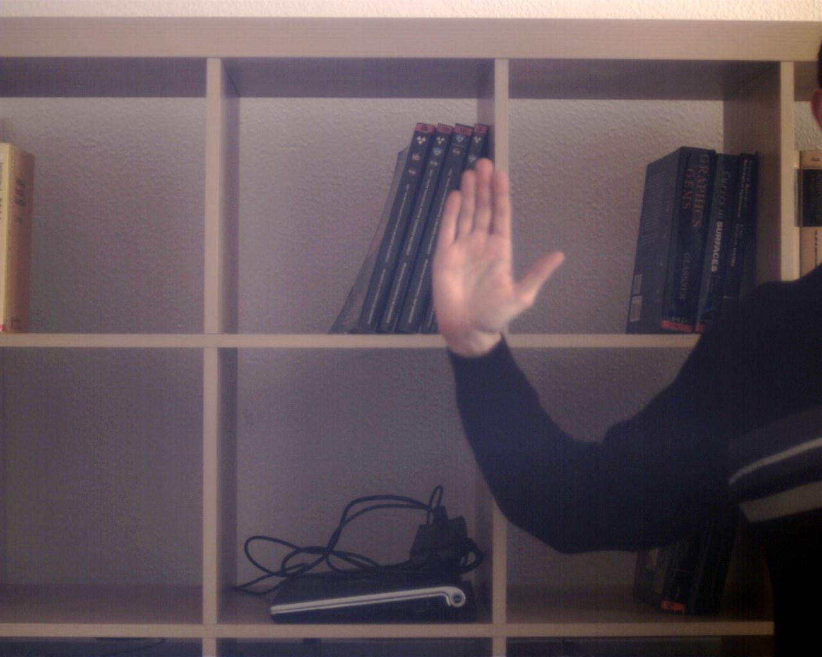
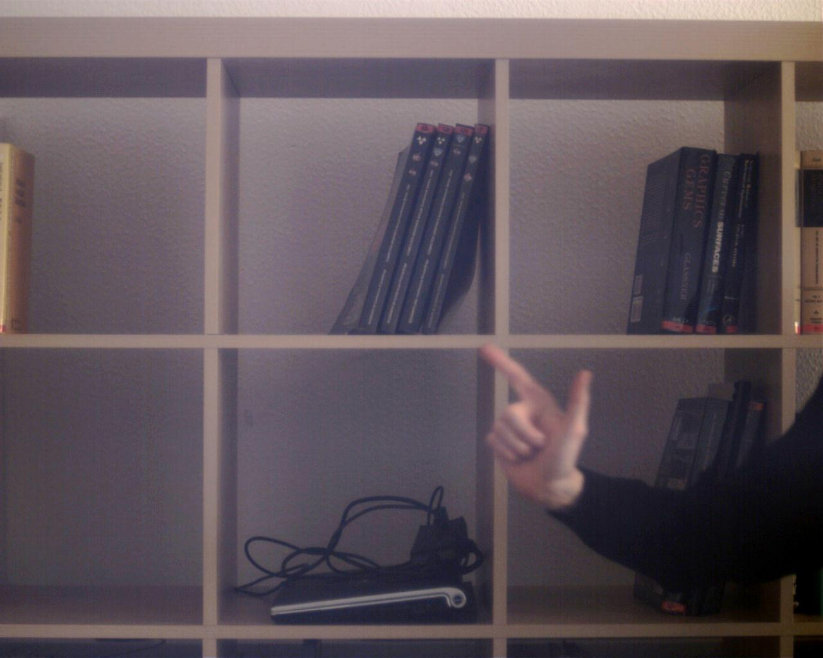
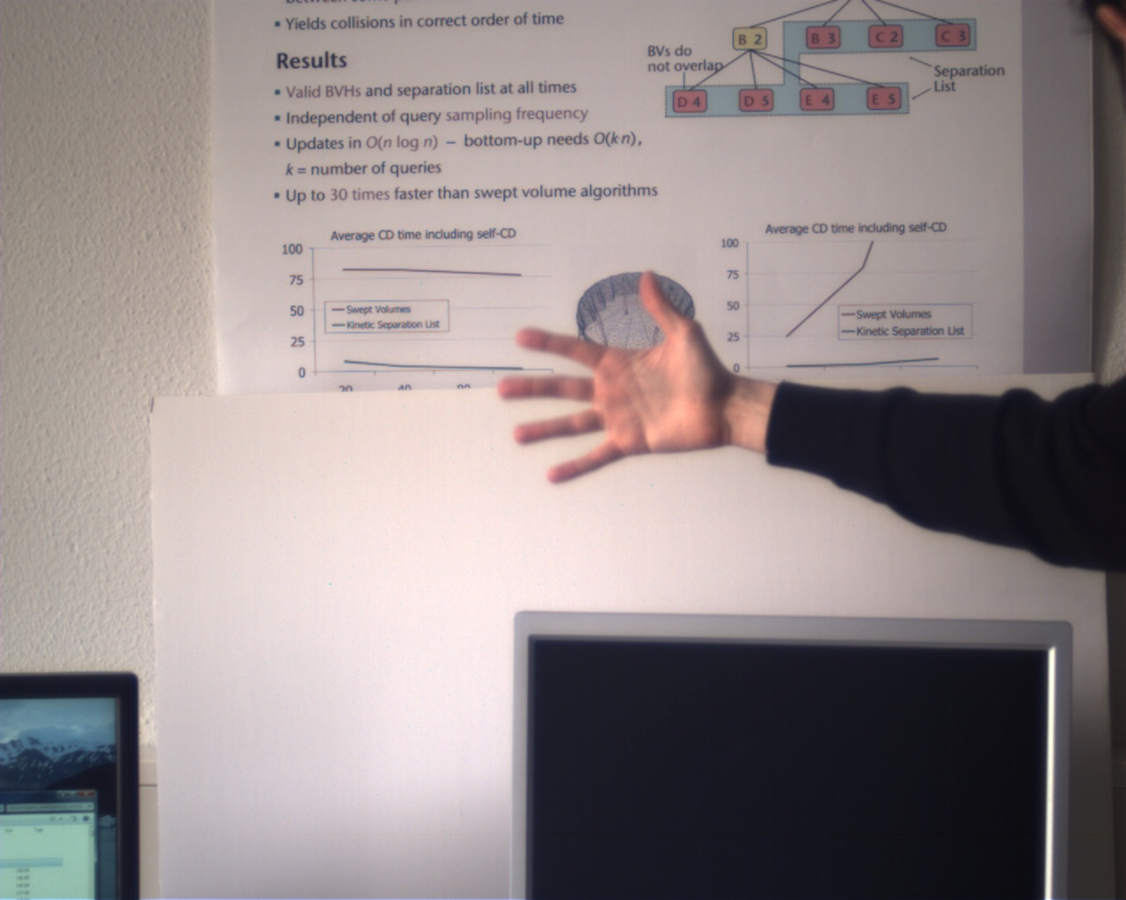
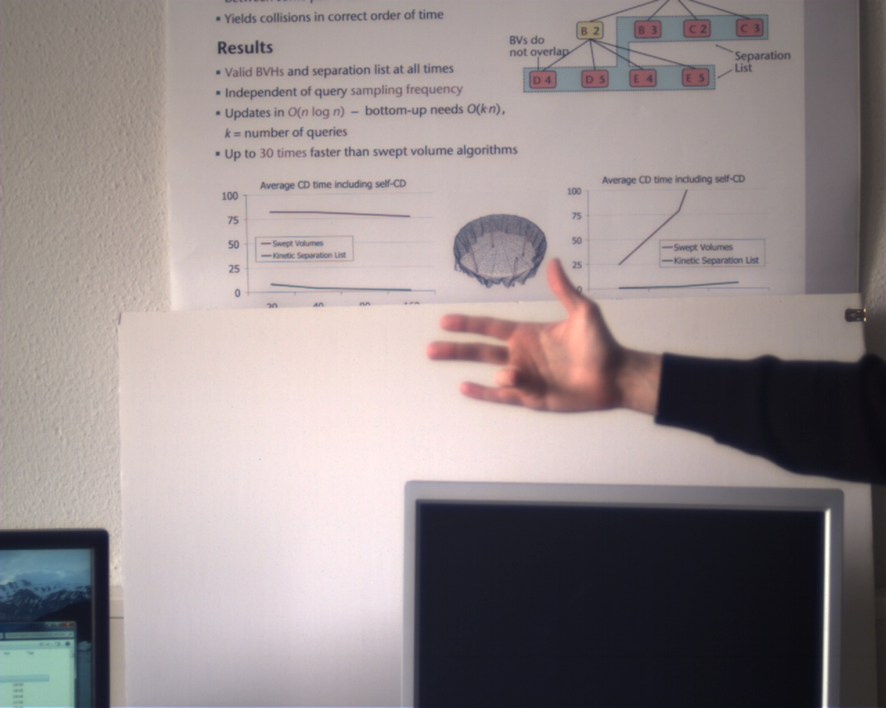
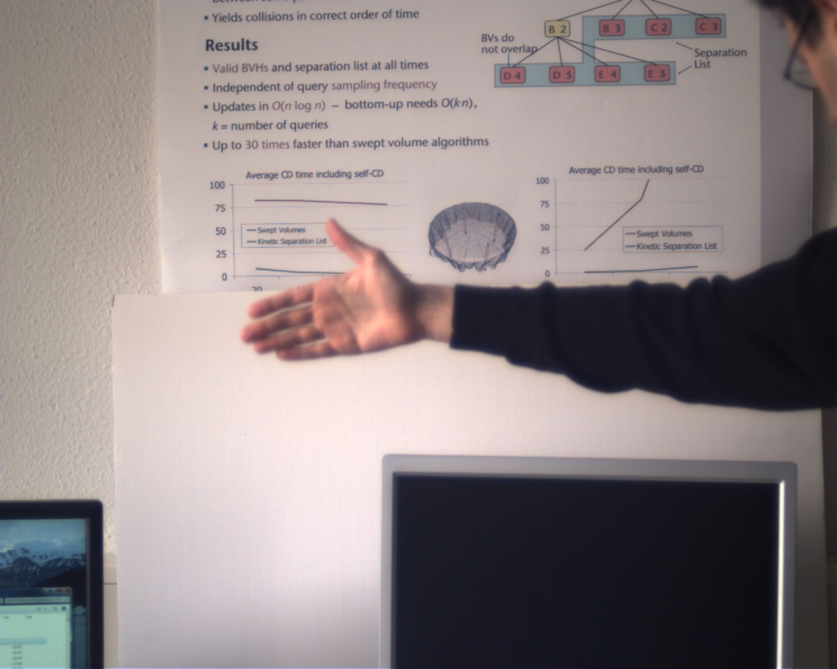
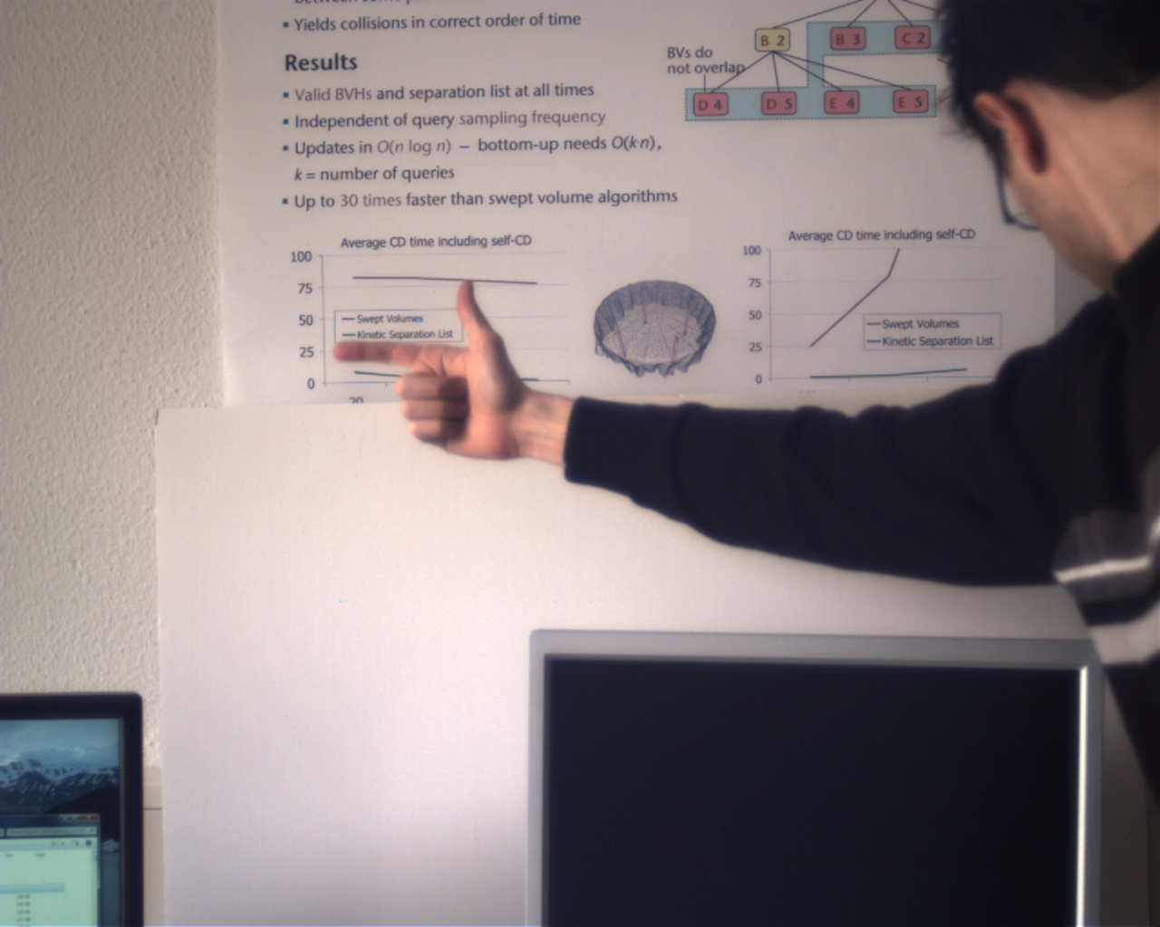
Experimental Evaluation
12 different test configurations
Abduction
Flexion
Open hand
Pointing hand
Skin-colored background
Partially skin colored background
No skin- color on background
Introduction Related Work Similarity Measure Poste Estimation Results Conclusions & Future Work
Notes:
We compare our approach to a skin segmentation based one.
Thus, we used 3 types of test datasets: skin-seg in bg,…
--
Kernel fkt k(x)=exp(-0.5x**2) und bandbreite h(=3.3, 4.0, 4.0)

Slide 12
Qualitative Evaluation
Skin segmentation
Our method
Brute-force
Coarse-to-fine
Introduction Related Work Similarity Measure Poste Estimation Results Conclusions & Future Work
Notes:
Due to the lack of ground truth data, we have decided to make video sequences for visual comparison

Slide 13
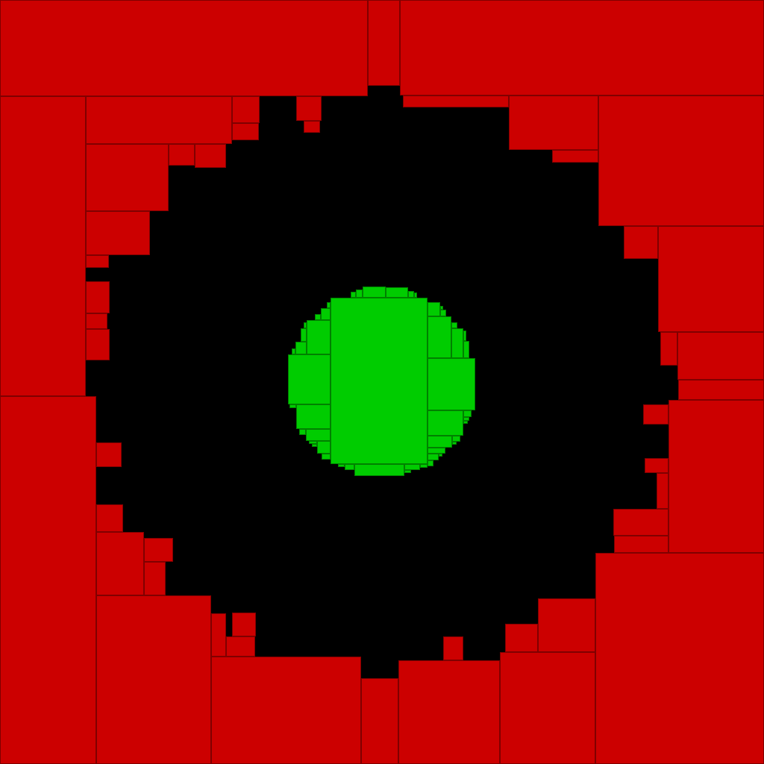
Qualitative Evaluation
Skin segmentation
Our method
Brute-force
root node
Coarse-to-fine
Introduction Related Work Similarity Measure Poste Estimation Results Conclusions & Future Work
Notes:
The 2nd video is very well suited for skin-seg based approach, so it was interesting for us to see if our approach works comparable well…

Slide 14
Computation Time
On 2.6 GHz CPU, in C++, not optimized
Our coarse-to-fine approach: 0.6 fps
Compared to brute-force:
Several minutes per frame
Hand tuned matching threshold, step size 12 pixel: 0.3 fps
On a Geforce GTX 480 GPU
30 fps
Introduction Related Work Similarity Measure Poste Estimation Results Conclusions & Future Work
Notes:
Some words to the computation time…
It is not fair to compate it to the brute-force, so we used a hand tuned....

Slide 15
Conclusions
Novel color divergence-based detection approach
No segmentation, no edge extraction, required
Tracking by detection approach, very fast on GPU
Extension from colors to other input modalities (e.g. depth values) straight forward
Not limited to hand tracking
Matching
Segmentation
Binarization
Sources of error
Computation time
Introduction Related Work Similarity Measure Poste Estimation Results Conclusions & Future Work
Notes:
To conclude my talk I have presented…
That eliminates another ERROR PRONE STEP from the tracking pipeline

Slide 16
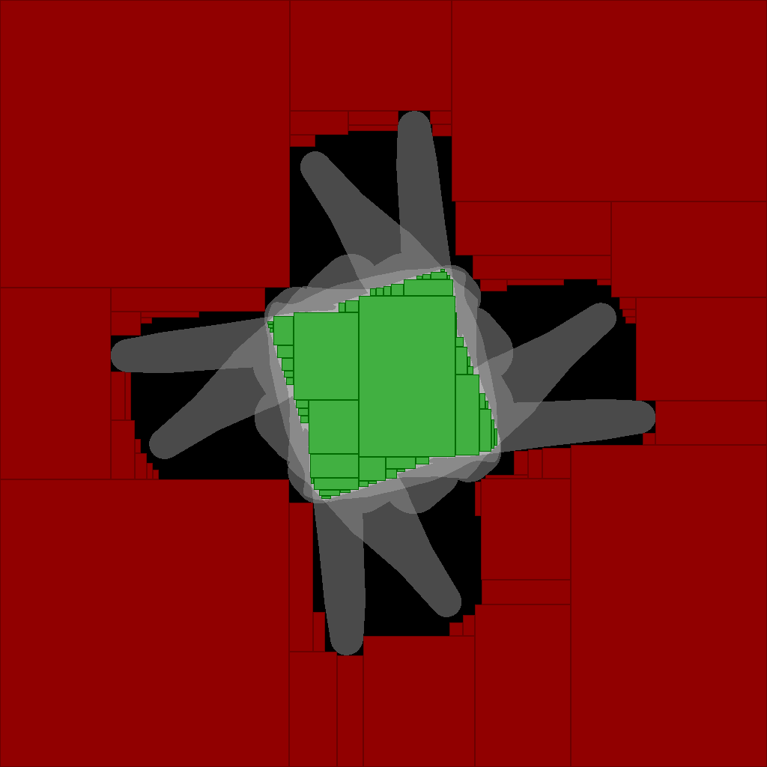
Future Work
Extend color distribution to
Mixture of Gaussians or
Non-parametric representation (higher computation cost)
Try to extract information from in-between region
Introduction Related Work Similarity Measure Poste Estimation Results Conclusions & Future Work

Slide 17
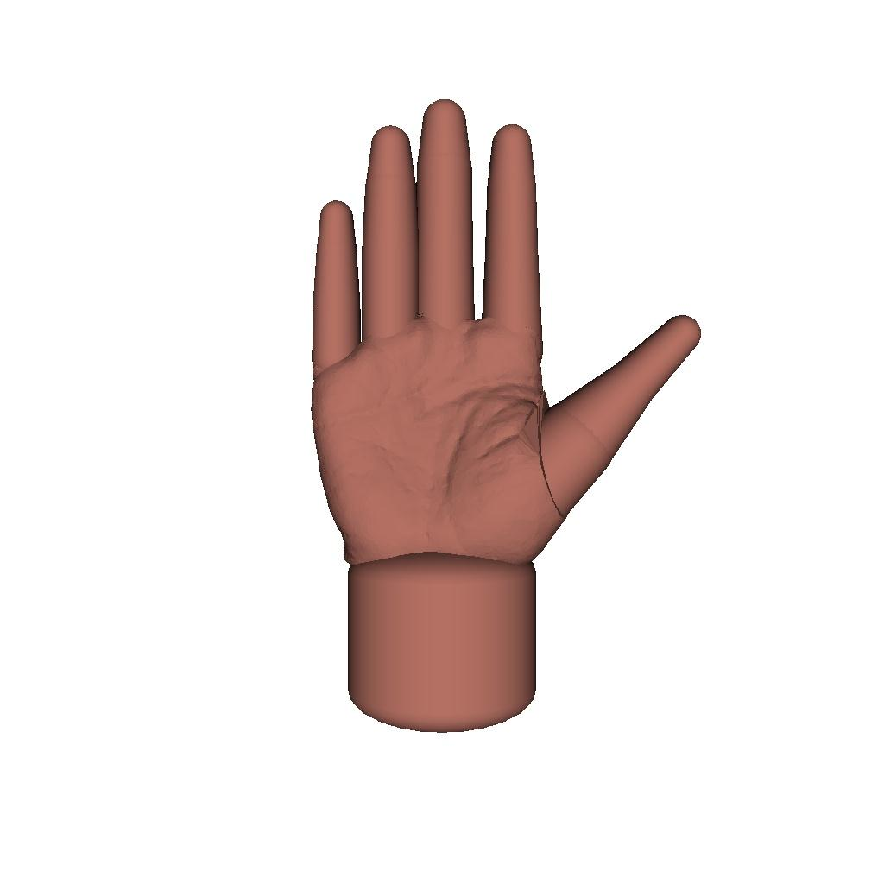
Thanks for your attention!
Questions?
Notes:
Thanks for your attention.
I will be happy to answer any questions

Slide 18
Evaluaton of Hand Detection Quality
Compare with a brute-force approach
Brute-force approach: match templates to all image positions
Higher matching quality
Very time consuming
Error Measure: Normalized RMS in pose space
Open hand
Pointing hand
Abducting fingers
Flexing fingers
Introduction Related Work Similarity Measure Poste Estimation Results Conclusions & Future Work
Notes:
Gleiche similarity measure und hierarchy,
Aber brute-force abscannen statt intelligente maximum finding
our method performs better in open hand and abducting finger seq.
The other 2 sets have smaller intersection area in root node
=> increases chances tree traversal finds good matches for nodes close to the root in image areas were there is no hand at all.
=> fewer match candidates remain for the true hand position during hierarchy traversal

Slide 19
Skin segmentation
Our method
Brute-force
Coarse-to-fine

Slide 20
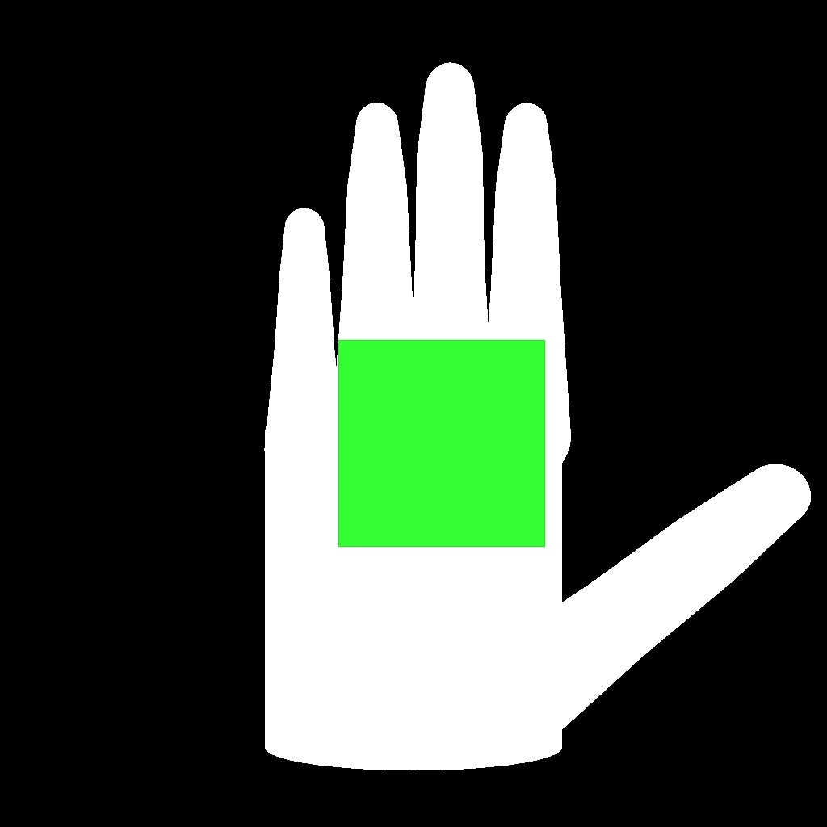
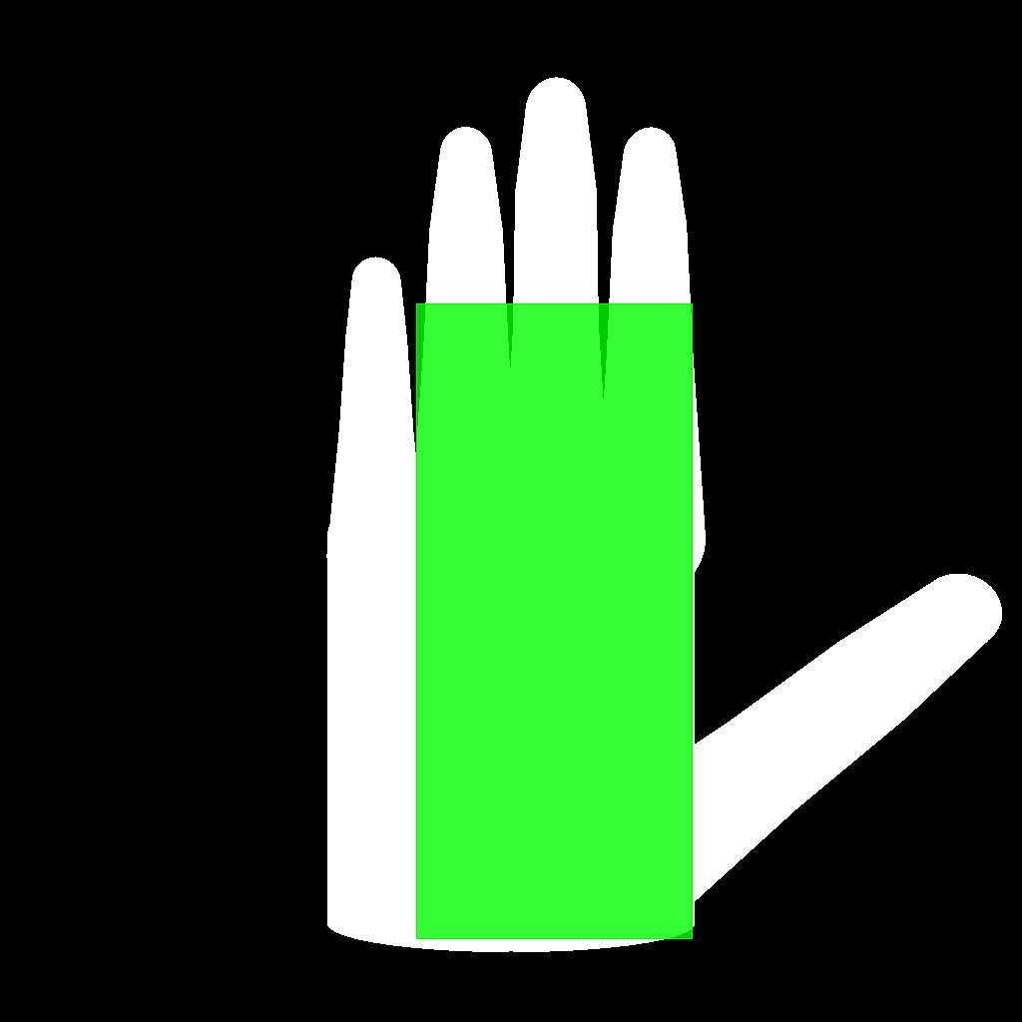
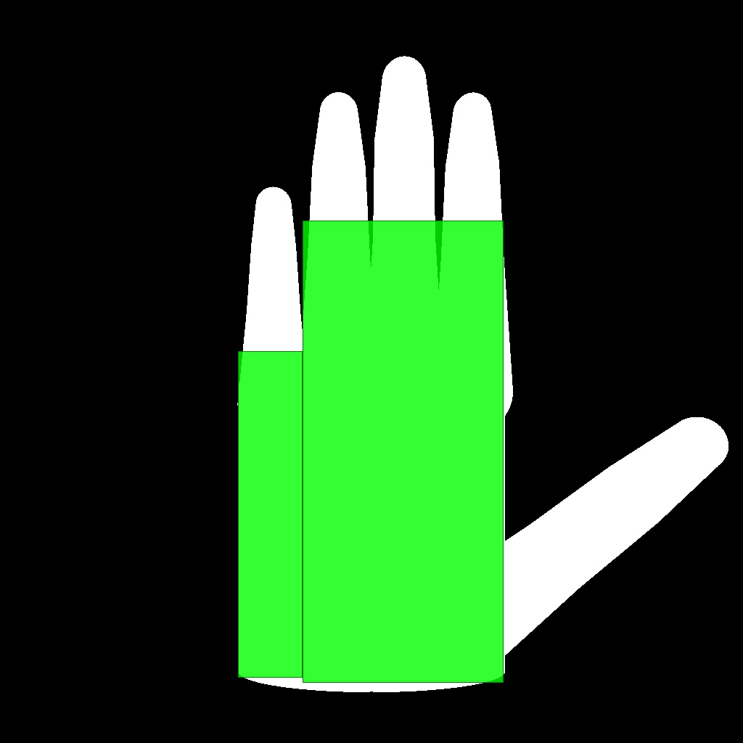
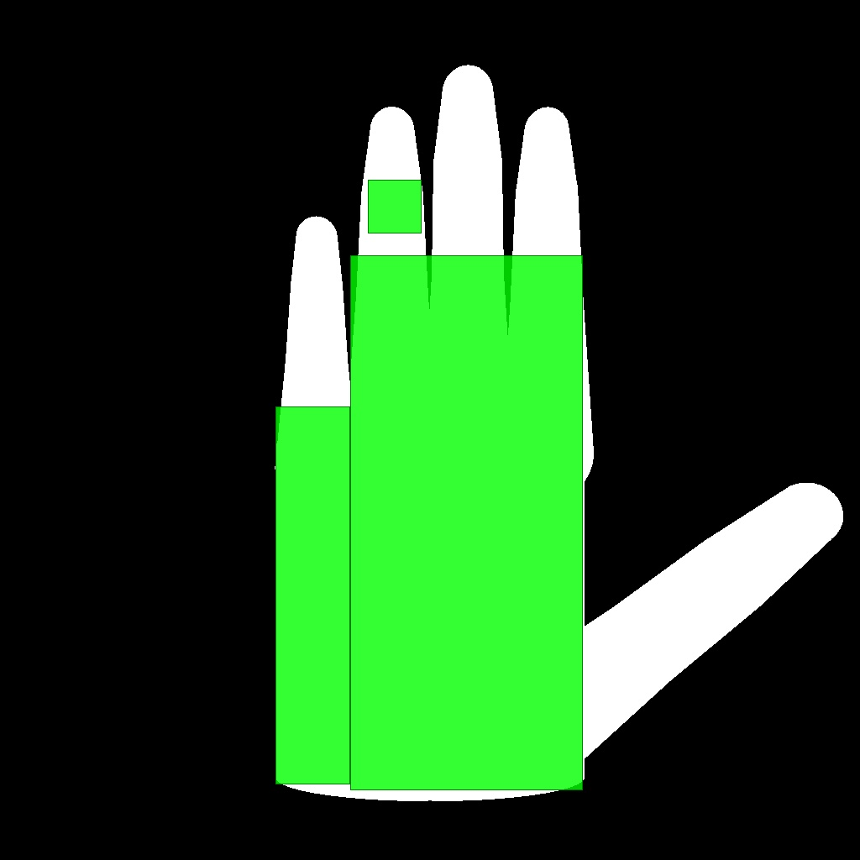
Rectangle Covering : Greedy Algorithm
Insert rectangle into foreground region
Define objective function based on covered area
Solve through standard optimization methods
Accuracy is an adjustable parameter
Introduction Edge gradient feature Skin-color feature Conclusions

Slide 21
Fast Estimation of Color Distribution
[FAST: Fast Adaptive Silhouette Area based Template Matching, Mohr and Zachmann, BMVC 2010]
For visualization purposes: grayscale image
Estimate color distrib. in template foreground
Compute integral image IS of input image
Use rectangular representation R of template T
Sum of rectangular area in input image Computation cost per rectangle: 4 look-ups in IS
(0,0)
-
+
+
+
+
Introduction Related Work Similarity Measure Poste Estimation Results Conclusions & Future Work
Notes:
For better understanding, we summarize the utilization of integral image for template matchin (publicated last year)
Handle foreground / background separate, then combine, for simplicity only foreground shown
---
\begin{split}
H(R_i) = \sum_{\vc x \in R_i} \log S(x) & = IS(R_i.\text{lower}.\text{right}) + IS(R_i.\text{upper}.\text{left}) \\
& - IS(R_i.\text{lower}.\text{left}) - IS(R_i.\text{upper}.\text{right})
\end{split}
--
P(S,\vc p, T) \approx P(IS,\vc p,R^*) = \exp\bigl( \sum_{R_i\in R^*} h(R_i + \vc p) \bigr)
---

Slide 22
Template Matching
 | Generate templates on-the-fly | Precompute templates
Number of templates | unlimited | limited to precom-puted poses
Storage space | constant | linear in #templates
Matching time | high | low
Additional structures (e.g. hierarchy) | almost impossible | possible
Appropriate for | local search | global search

Slide 23
Our Novel Tracking Pipeline
Color distribution estimation
Multiple hypothesis tracking
foreground
cmp
Template hierarchy
background
Introduction Related Work Similarity Measure Poste Estimation Results Conclusions & Future Work

